Slide 1
3D Printing DIY
IRC CG&CF
Notes:
各位老师同学，大家早上好，我是3D打印组组长刘晓康，今天我将为大家介绍3D 打印的DIY内容

Slide 2
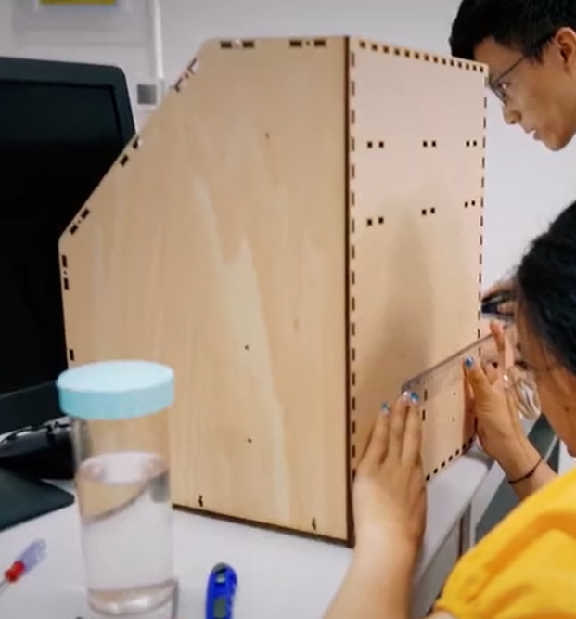
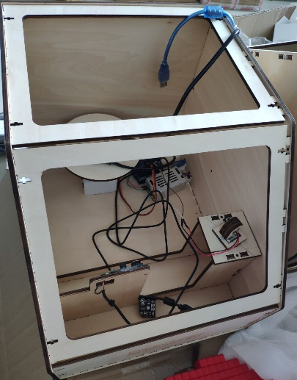
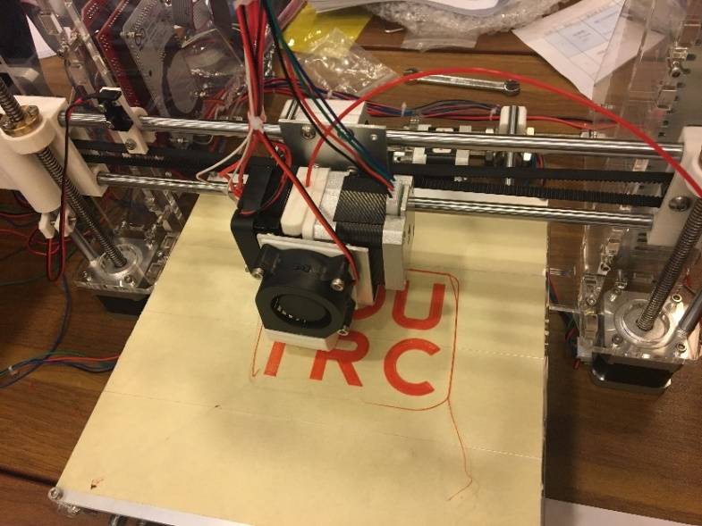
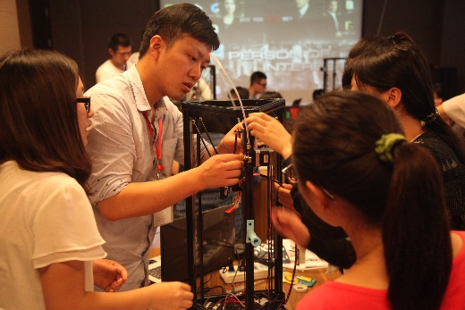
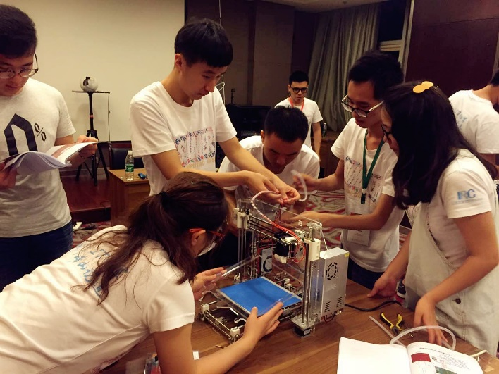
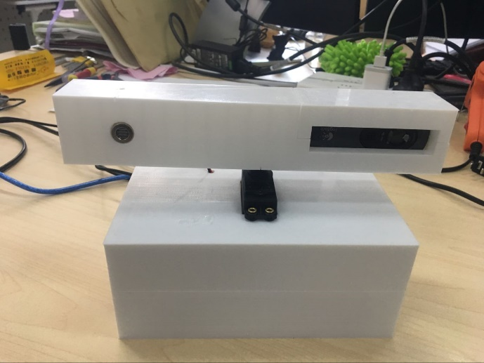
Review of the past（2015~2019）：
2015
Assembly of a Delta-printer
2016
Assembly of an XYZ-printer
2017
Assembly of an XYZ-printer & 3D reconstruction based on Artec-scanner or Kinect
2018-2019
3D reconstruction & 3D printing
Notes:
从15年开始，我们每年都会为大家提供丰富有趣的DIY课题，从组装Delta打印机，XYZ打印机再到打印组装扫描仪进行三维重建和打印。但是因为今年的特殊情况，我们只能在线上开会，虽然没办法让大家近距离接触打印机

Slide 3
3D Printing DIY @2020
DIY introduction:
This topic provides students with two DIY projects, based on a standard FDM (Fused Deposition Modeling) 3D printer and a clay 3D printer.
Students will understand the whole printing process from modeling to manufacturing through the projects, and fabricate the results through the above printers.
Notes:
但我们还是为大家提供了两个有趣的DIY课题，以及标准的FDM打印机和陶泥打印机，保证大家可以通过这些课题充分的体会理解从建模到制造的整个打印流程。

Slide 4
3D Printing DIY @2020
#1 Path Design for Clay Printing based on G-code
[CERAMBOT Plus]
[CERAMBOT Mini]
Notes:
首先第一个课题是基于G-code的陶泥打印路径设计，这里我们会提供plus陶泥打印机

Slide 5
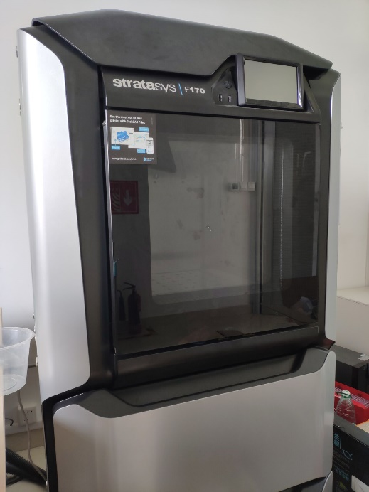
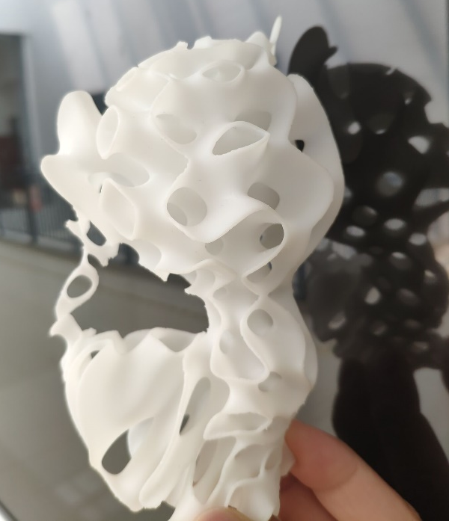
3D Printing DIY @2020
#1 Path Design for Clay Printing based on G-code
#2 TPMS Porous Model Generation and Fabrication
[Stratasys F170 Printer]
A kitten based on TPMS
Notes:
第二个题目是TPMS多孔模型的生成和制造，这里我们会提供Stratasys F170 打印机

Slide 6
3D Printing DIY @2020
#1 Path Design for Clay Printing based on G-code
Problem Description:
Given a certain volume of clay, students design the printing path to generate the G-code file that can be directly fabricated on a 3D printer.
Requirements:
One single continuous printing path.
The generated model should be support-free.
There is no self-intersection in the printing path.
Notes:
第一个题目的要求是，大家自行设计一条陶泥打印的路径，保存为G-code文件，然后交由打印机打印出模型。这里有三条要求：
首先，要是一条单一连续的打印路径；其次，由路径得到的模型应是免支撑的；第三，路径之间没有自交

Slide 7
3D Printing DIY @2020
#1 Path Design for Clay Printing based on G-code
G-code specification:
$$G1 F∗∗∗ X∗∗∗ Y∗∗∗ Z∗∗∗ E∗∗∗$$
F: the speed of print nozzle printing line XYZ in mm/min, here we recommend F=1800 mm/min;
X, Y, Z: the coordinate of the target position of the print nozzle;
E: the cumulative extrusion volume of clay from the beginning to current layer.
Notes:
那么G-code是什么呢？它是一系列控制打印设备运动的命令。接下来大家需要了解一下G-code的书写规范。最主要的一条就是G1，用来控制喷头移动，F是速度，XYZ是喷头目标位置的坐标，E是从开始到当前步的陶泥挤出总量

Slide 8
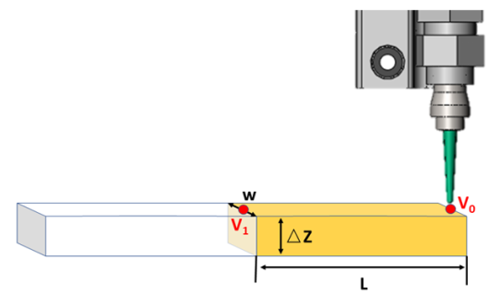
3D Printing DIY @2020
#1 Path Design for Clay Printing based on G-code
Extrusion volume of clay from point V₀ to V₁:
$$e=αLw∆z$$
The cumulative Extrusion volume at V₁:
$$E_{V1}=E_{V0}+e$$
In this DIY topic，we recommend ∆z =1.2mm , w = 3mm, $α$ = 0.4.
Notes:
想要计算陶泥总挤出量E，就需要计算每一步陶泥的增量，我们用e表示，那么e=$αLw∆z$；
是打印机内参系数，L为两点距离，W为平均宽度，∆z为平均层高。
那么在V1点处总的挤出量可以表示为上一步的总挤出量加该步的增量。
在本课题中，我们建议将

Slide 9
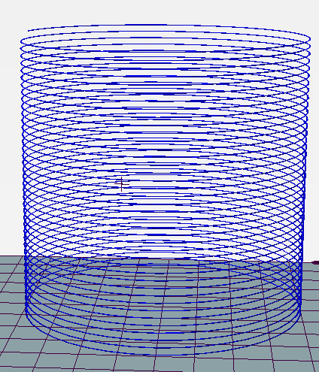
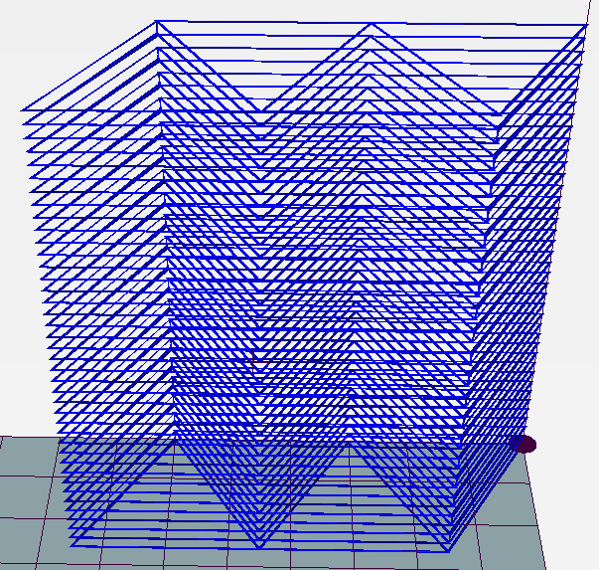
3D Printing DIY @2020
#1 Path Design for Clay Printing based on G-code
Examples:
Simple Shapes
1
Notes:
可以从以下多个角度来设计gcode路径:
第一种是简单形状，大家可以直接书写gcode生成这种简单的圆柱或者棱柱，但是要注意保持路径的连续

Slide 10
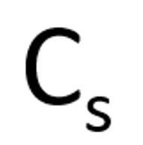
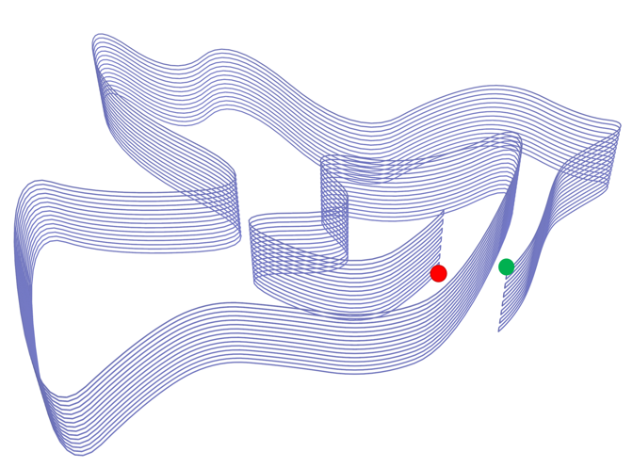
3D Printing DIY @2020
#1 Path Design for Clay Printing based on G-code
Input
Examples:
Simple Shapes
1
Sweeping Surfaces
2
Sweeping surface
Notes:
第二类是扫掠方式。学员们可以选择任意一条曲线C_{s}, 将C_{s}沿着路径曲线ψ进行扫掠，计算每一层点的位置，得到gcode文件。

Slide 11
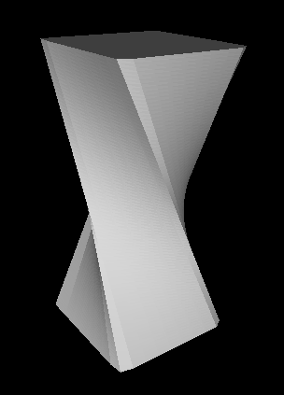
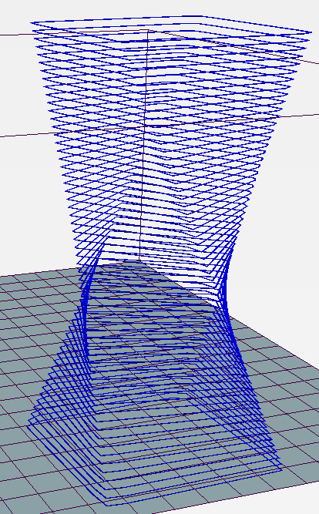
3D Printing DIY @2020
#1 Path Design for Clay Printing based on G-code
Examples:
Simple Shapes
1
Sweeping Surfaces
2
Modeling and Slicing
3
Notes:
大家也可以使用建模软件设计模型，通过切片得到对应的gcode。由该方法生成路径时，需要保证路径满足前文提到的三条要求。

Slide 12
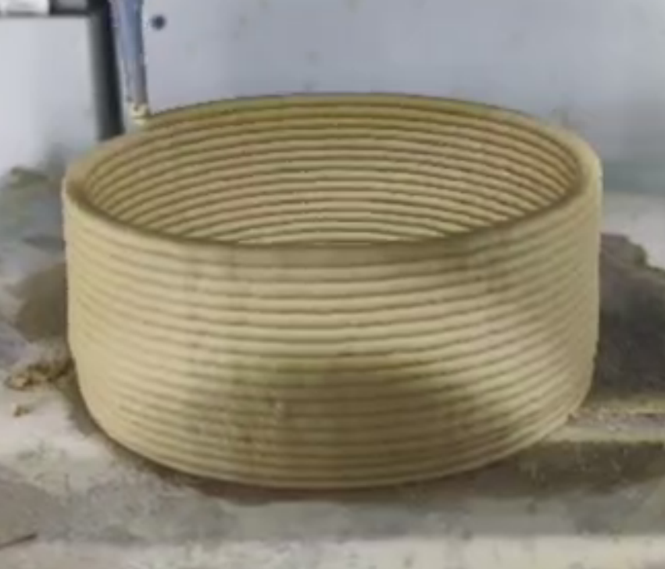
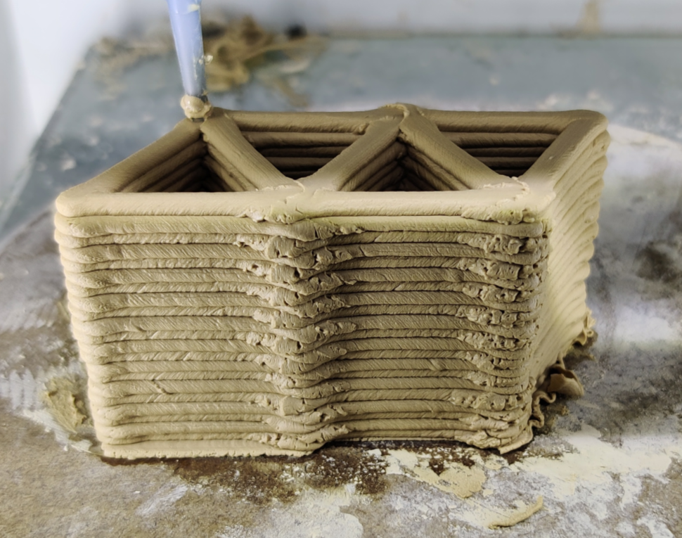
3D Printing DIY @2020
#1 Path Design for Clay Printing based on G-code
Fabricated results：
The G-code designed by students can be directly used to print on our clay printer. We also provide live broadcast, to enable students to witness the process of printing according to their work.
Some fabricated results
Notes:
大家设计的G-code文件会直接用我们的陶泥打印机进行打印，我们也提供直播，让大家可以近距离观看自己设计模型的打印过程。下面是三个简单的示例结果，对应的gcode我们会放到教程中，供大家参考

Slide 13
3D Printing DIY @2020
#2 TPMS Porous Model Generation and Fabrication
Problem Description:
Students are supposed to design TPMS structure on a basic framework based on libigl, and utilize relevant modeling software to generate a porous model based on such TPMS structure. and make use of the provided 3D printer for manufacturing.
TPMS（Triply periodic minimal surface）^{[1]} is one of the minimal surfaces.
[1] Computer-aided porous scaffold design for tissue engineering using triply periodic minimal surfaces[J]. Yoo D J. International Journal of Precision Engineering and Manufacturing, 2011.
Notes:
第二个题目，TPMS多孔模型的生成与制造。
学员首先需要了解TPMS的相关知识，然后在一个基于libigl的基础框架上，进行TPMS结构的设计，利于相关软件生成TPMS多孔模型，并利用提供的3D打印机进行制造

Slide 14
3D Printing DIY @2020
#2 TPMS Porous Model Generation and Fabrication
DIY content：
Download and configure Libigl
Libigl is an open source C++ library for geometry processing, and it is suitable for students who are newbie to graphics processing.
In addition, Libigl is header-only, with detailed and easy-to-understand tutorial.
Notes:
该课题的第一步是下载配置libigl，这是一个开源的c++库

Slide 15
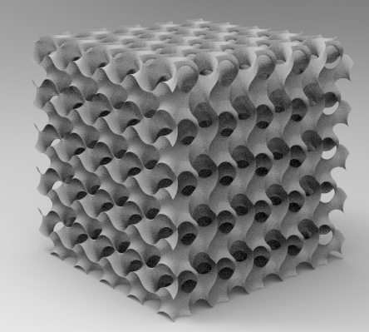
3D Printing DIY @2020
#2 TPMS Porous Model Generation and Fabrication
DIY content：
2. Generate the TPMS grid model
Select anyone of the TPMS functions (implicit equations) for coding;
Calculate the coordinates of corresponding Voxel and the function values of TPMS at this location;
Generate the TPMS grid model based on scalar Field and Vertex Locations.
Notes:
接下来，选定一种TPMS表达函数进行编码；利用marching cube算法计算对应voxel的坐标及函数在此位置的值；
利用上述数据生成右图所示的TPMS多孔模型。

Slide 16
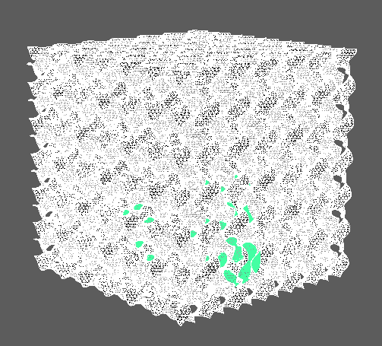
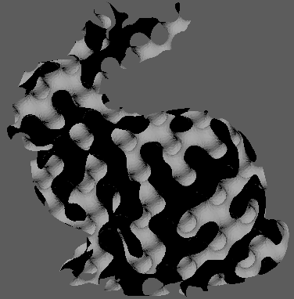
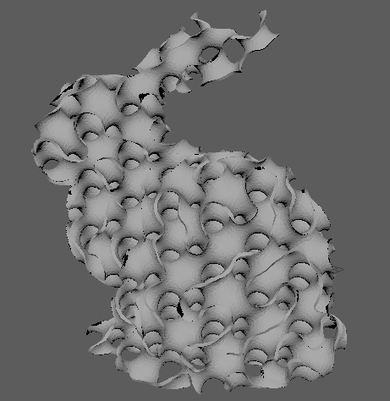
3D Printing DIY @2020
#2 TPMS Porous Model Generation and Fabrication
DIY content：
3. Intersect the TPMS model with the target model to obtain the TPMS porous model.
Models intersection
A porous bunny based on TPMS
Extruding thickness of the model
Notes:
将TPMS模型与其他模型求交，得到TPMS多孔网格模型。通过挤出厚度等后处理操作得到最终的可打印模型。

Slide 17
3D Printing DIY @2020
#1 Path Design for Clay Printing based on G-code
#2 TPMS Porous Model Generation and Fabrication
Notes:
上述两个题目，大家可以任选其一，如果对两个题目都感兴趣，可以在完成第一个之后去尝试另一个。

Slide 18
Enjoy your DIY ！
Notes:
希望大家能享受我们的diy，享受本次暑期学校，谢谢！

Slide 19
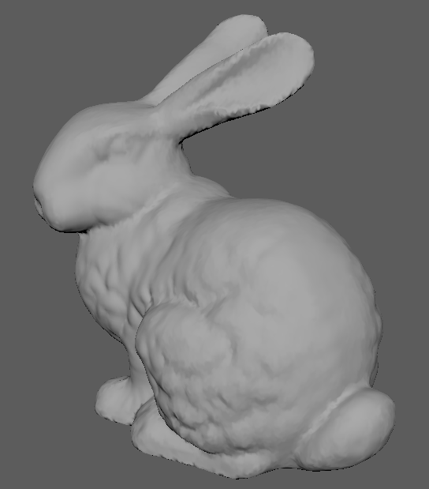
3D Printing DIY @2020
#2 TPMS Porous Model Generation and Fabrication
Fabricated result：
The models designed by the students will be printed on our Stratasys F170 printer.
TPMS grid model reconstructed by Tubular G & bunny
Models intersection
A porous bunny based on TPMS
Extruding thickness of the model
Notes:
这是一个标准的流程示例，大家设计的模型最后也会通过Stratasys F170 打印机打印出来

