Slide 1
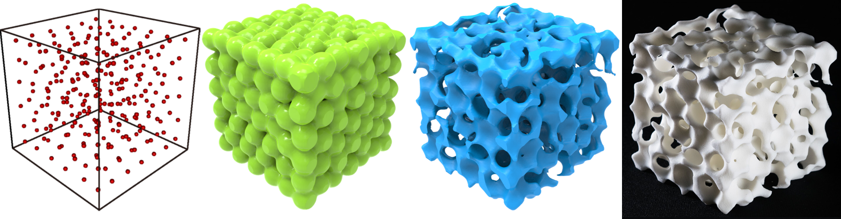






Organic Open-cell Porous Structure Modeling
Lihao Tian, Lin Lu*, Weikai Chen, Yang Xia, Charlie C. L. Wang, Wenping Wang
Notes:
Thank you very much.
I’m Tian Lihao from Shandong University.
I’m going to talk about the organic open-cell porous structure modeling.

Slide 2

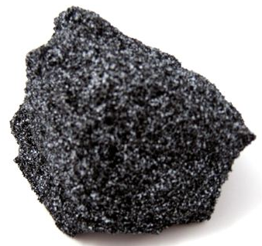
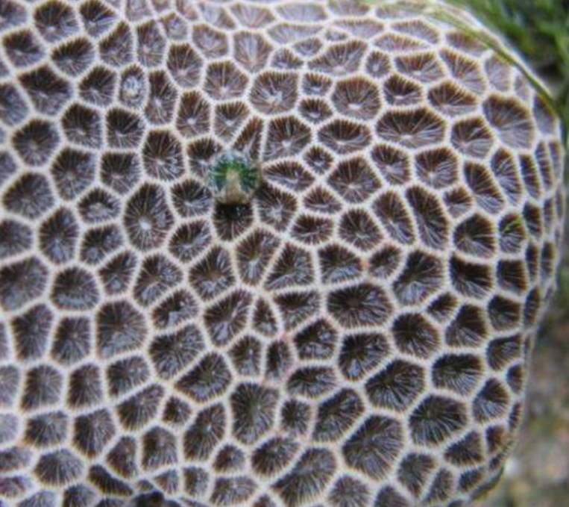
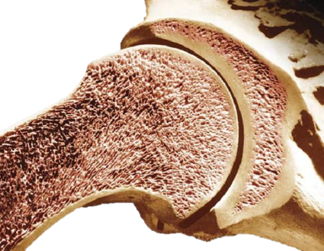
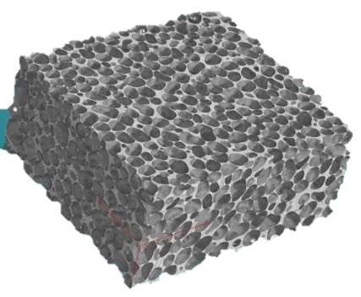
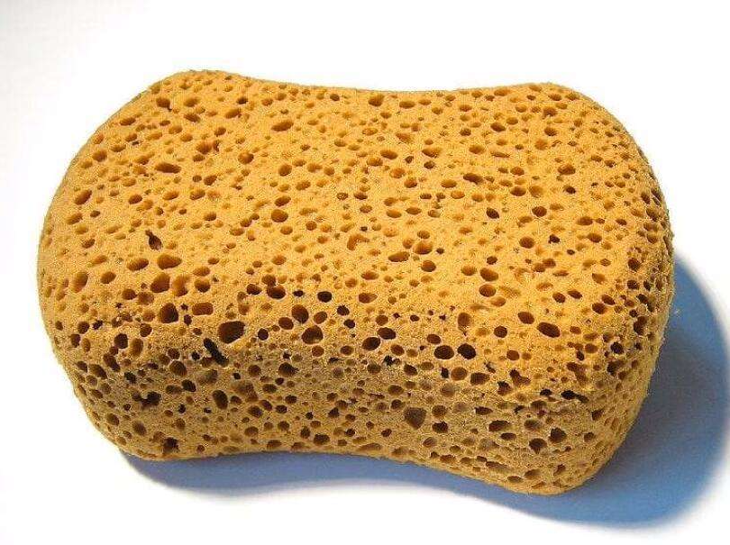
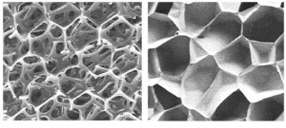
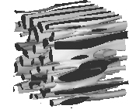
Organic Porous Materials
Soap bubble
Rock
Coral reef
Bone
Metal foam
Sponge
Closed-cell
Open-cell
Cells are isolated from each other and cavities are surrounded by complete cell walls.
Cells are connected with each other.
Isotropy
Anisotropy
Notes:
Porous structures can be found everywhere in nature.
For example the bubble, sponge and bone structure.
There are two categories of the cells. Closed cell and Open cell. Let me introduce these properties at first.
In this work, we prefer the open cell in the fabrication. Because it is not allowed to clean up the remaining internal materials, during the 3D printing, in the closed cells. And also in medical models, closed cells are not allowed at all.
Anisotropy means objects have different properties in different directions.
These two figures of the closed-cell and open-cell are isotropic. They are stochastic, and will show the same mechanical properties at any direction.
Specifically, the open-cell and anisotropic porous structure, provides pretty good physical properties and printability.

Slide 3
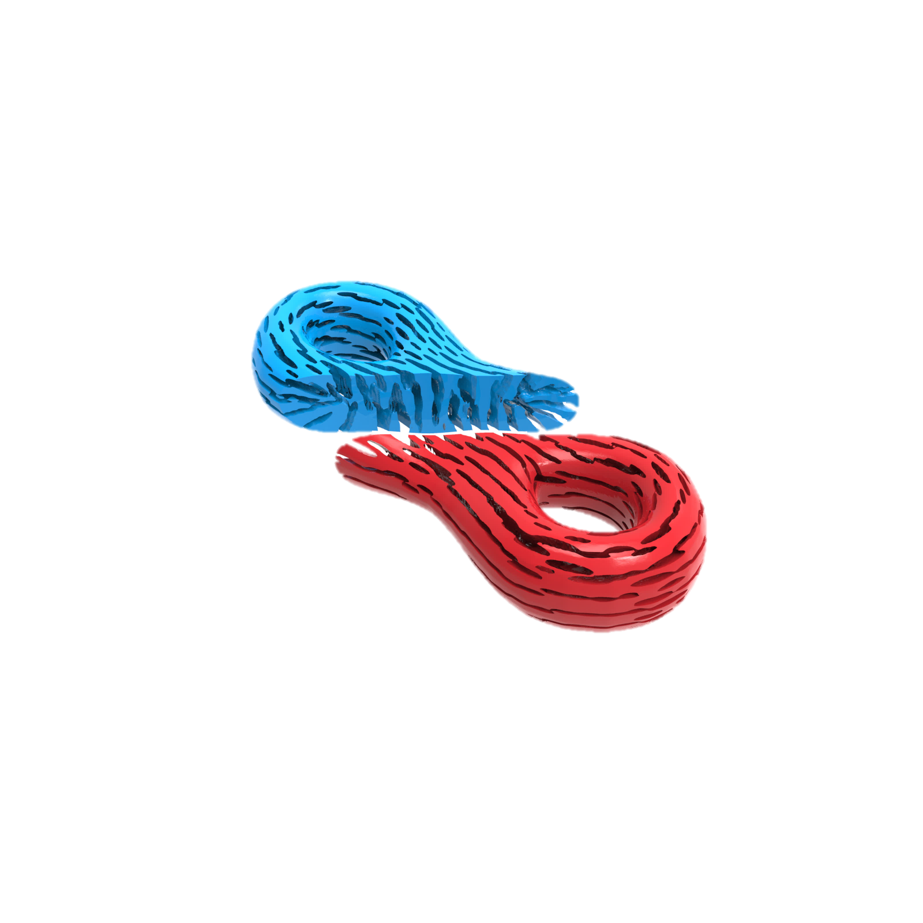
Organic Porous Structure: Modelling Objectives
Printability
  Connected solid
Permeability
  Connected pores
Adaptability
  Anisotropy along with the tensor field
Functionality
  Target porosity or mechanical properties
Connected Solid
Connected Pores
Anisotropy
Notes:
Our goal is achieve these abilities at the same time.
Printability and Permeability, need the solid and pores are fully connected.
We must make sure the structure is open-cell.
This blue model is the solid part, and the green model is the pore structure corresponding to it.
As we can see, the green part is fully connected, so the model is open-cell.
Other natural requirement is anisotropy. It can be controlled by a tensor field.
Besides them, We want to find a way, to directly control the pores inside the structure, to get target porosity and other functionality.
For the organic porous structure modeling, our modeling framework is the first one to achieve all the requirements.

Slide 4
Our Ideas
Follow the anisotropy from a tensor field
Represent each pore as a transformed Gaussian kernel
Model the porous structure as a level surface
Employ Morse-Smale complex to enforce the connectivity
Notes:
I list our ideas here.
We use tensor field and transformed Gaussian kernels, to achieve the anisotropy requirement.
We use level set to divide the solid part and pores.
And then the concept called Morse-smale complex, helps us guarantee the connectivity.

Slide 5
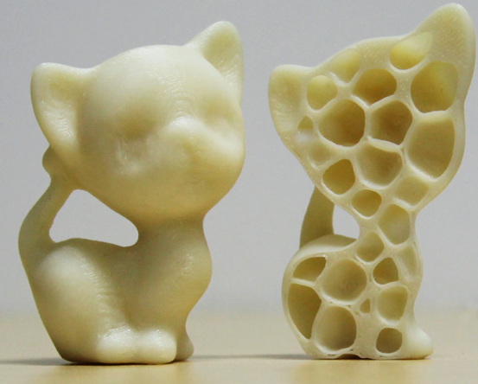
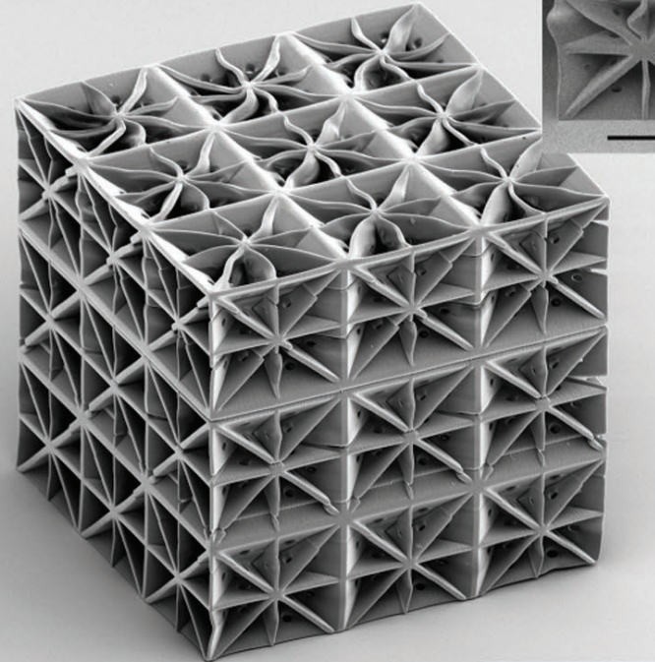
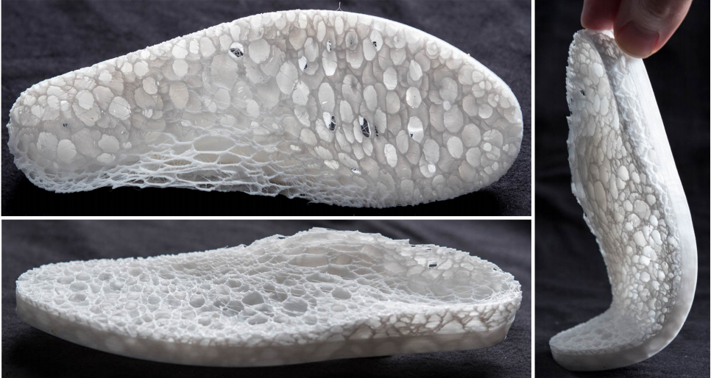
Related Work
[Lu et al. 2014]
[Tancogne-Dejean et al. 2018]
[Martínez et al. 2018]
Notes:
Let me introduce related work.
There are many porous structure modeling related work proposed these years.
For example the centroidal voronoi tessellation, mimics the honeycomb structure. And the plate-lattices is one kind of microstructure.
These work optimize model’s strength.
And Martinez use anisotropic Voronoi to get high elasticity.
These projects can generate models with good physical properties. However, they generate closed-cell structures, which is not our goal.

Slide 6
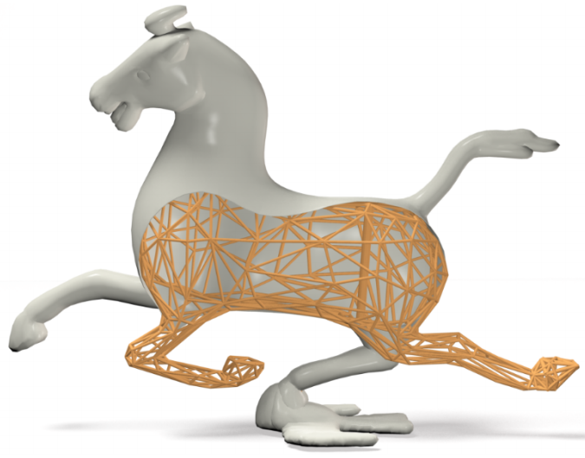
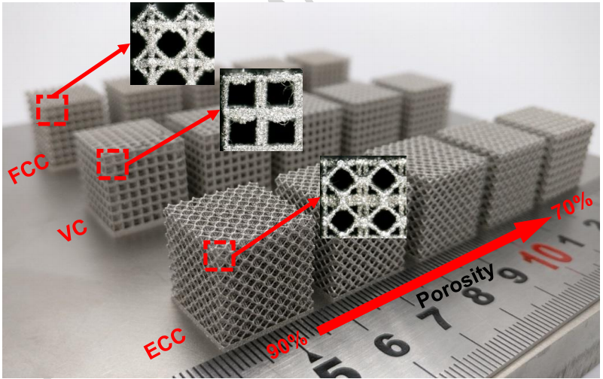
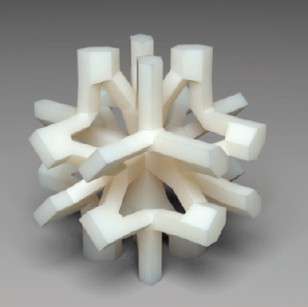
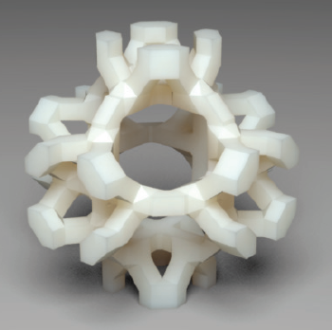
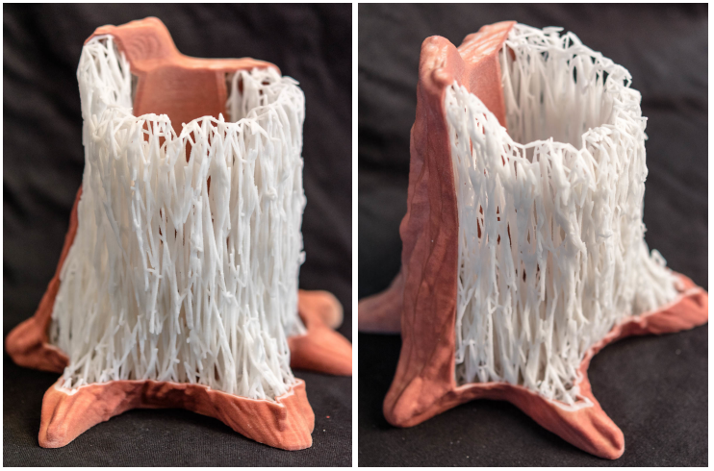
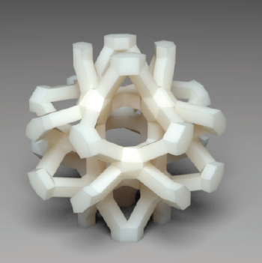
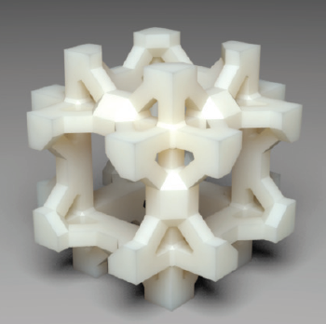
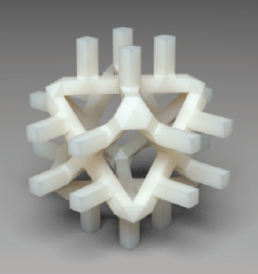
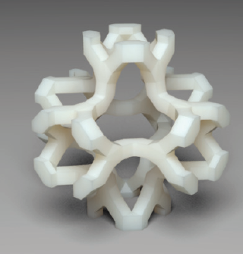
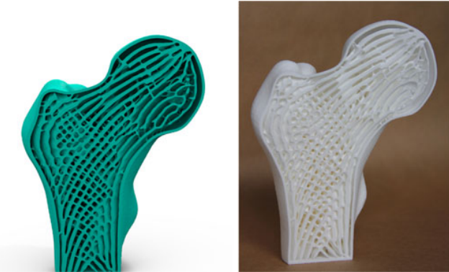
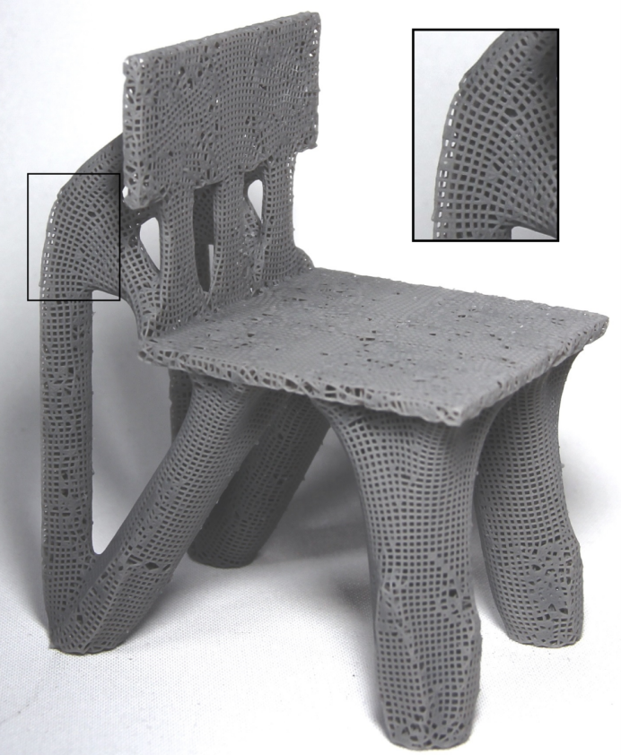
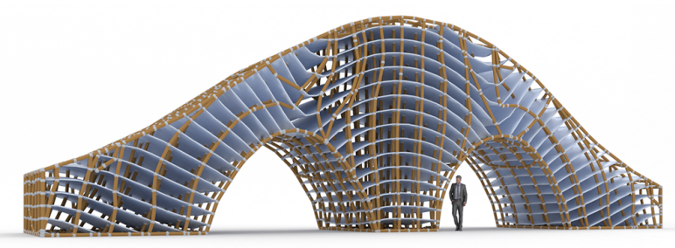
Related Work
[Wang et al. 2013]
[Andreassen et al. 2013]
[Panetta et al. 2015]
[Martínez et al. 2017]
[Wu et al. 2018]
[Wu et al. 2019]
[Arora et al. 2019]
Notes:
These structures contains metamaterial design, edge structure of anisotropic Voronoi, and strength optimization, for example the topology optimization.
These structures can be seen as the open-cell, because we can easily confirm, the hollowed part inside the model is connected.
But they are based on the truss.
The appearance is not similar to the natural porous structure. It’s very hard to tell where is a single pore inside the structure.
And we want to control it by the pores directly.
So, their good methods are not suitable for us.

Slide 7
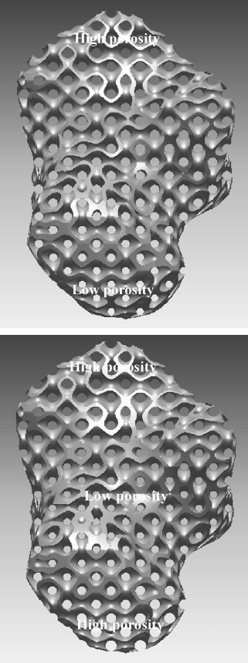
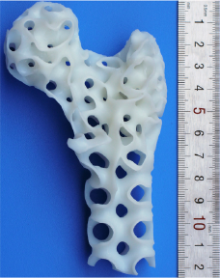
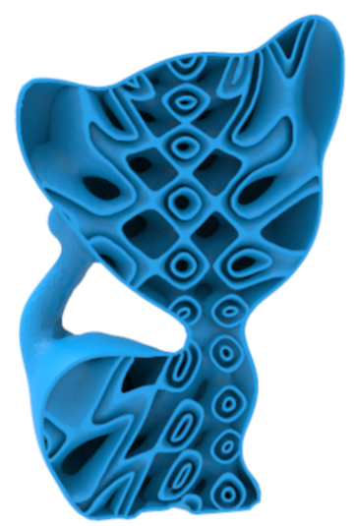
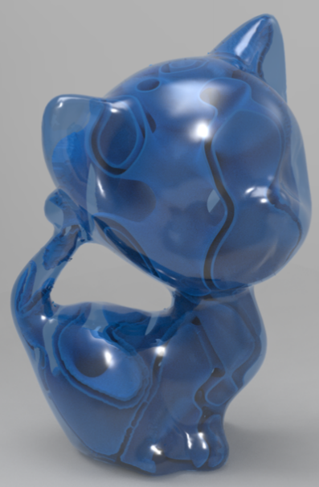
Related Work
[Yoo et al, 2012]
[Feng et al, 2018]
[Yan et al, 2019]
Notes:
TPMS is other kind of inner structure design.
They can offer smooth surface inside the model and make sure the void part is connected.
However, this structure divides the void to 2 parts. And it is hard to fit a complicated tensor field, like, the direction of tensor change rapidly in the field. So, the TPMS is not suitable to represent anisotropy.

Slide 8
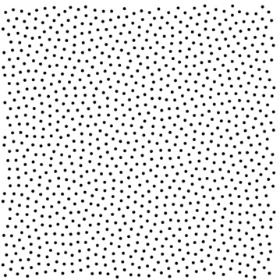
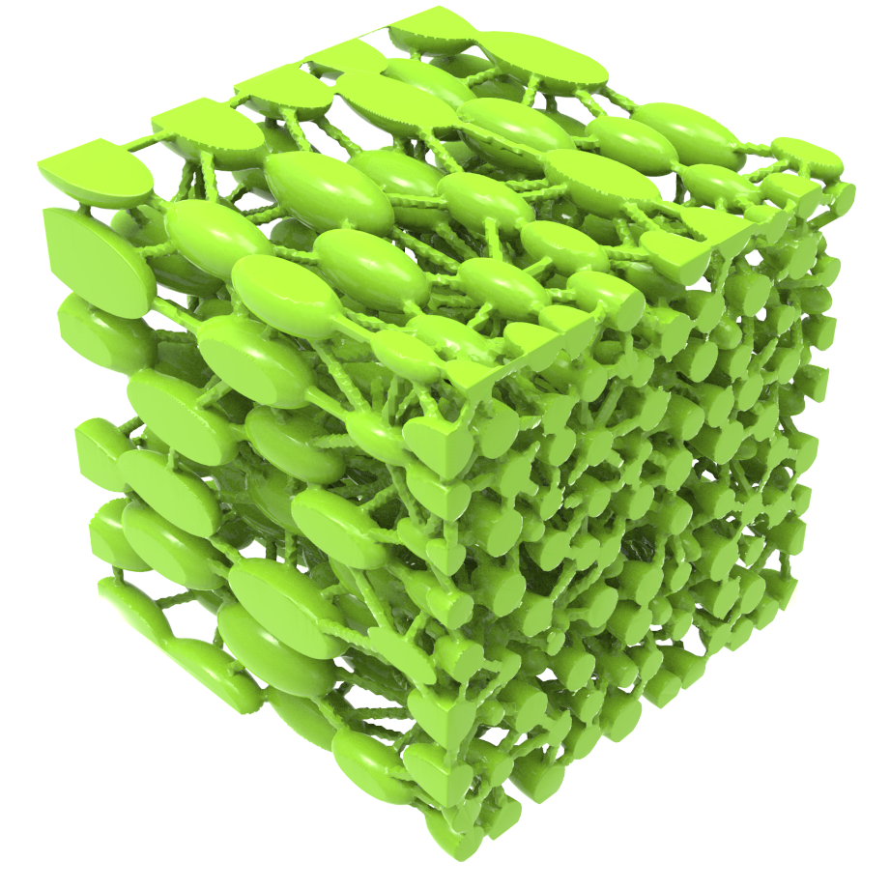
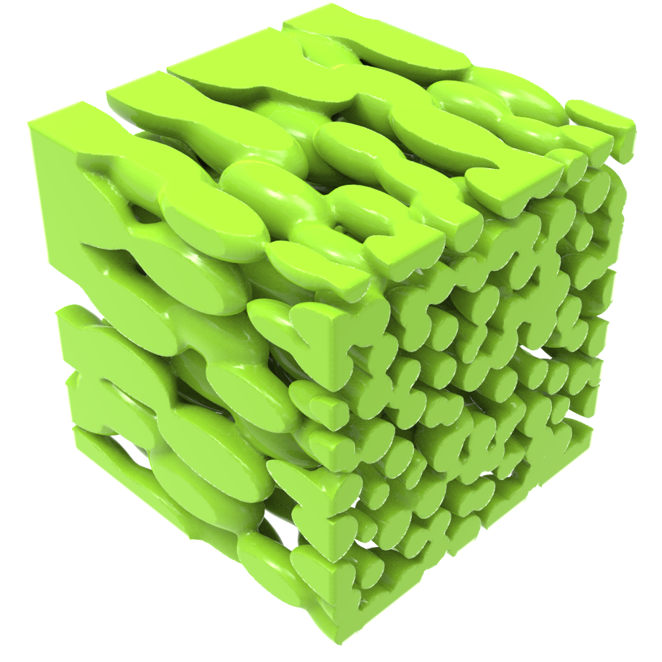
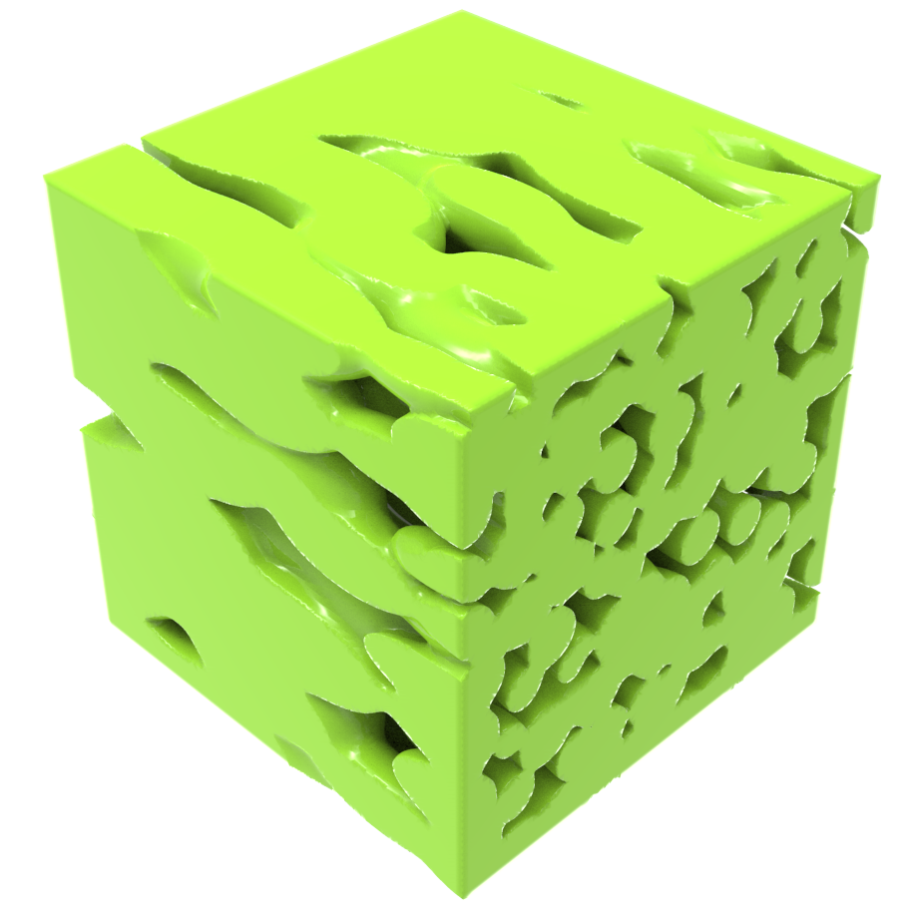
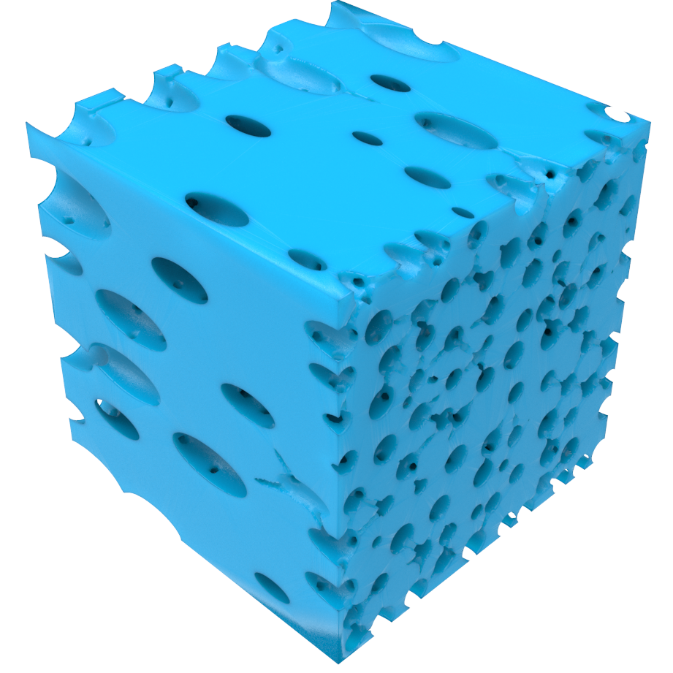
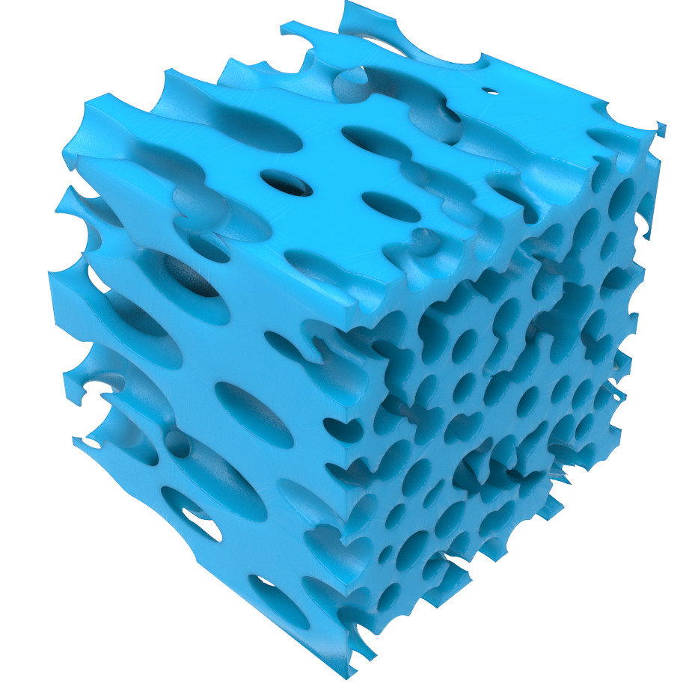
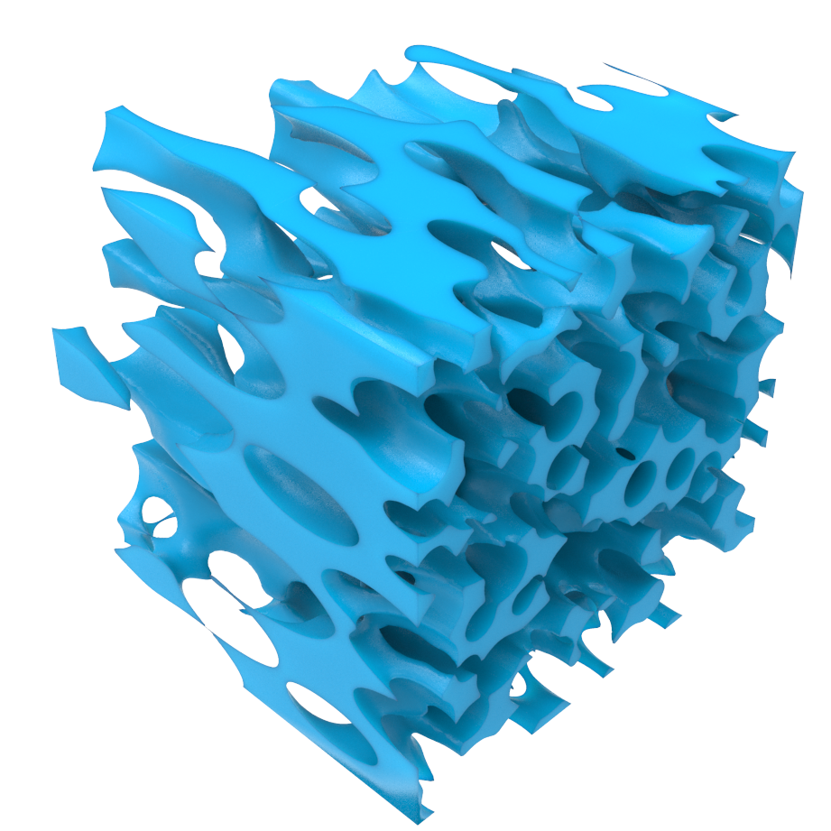
Pipeline
Input tensor field
Blue-noise Sampling
Transformed Gaussian Kernels
Porous Structure Extraction
MSC Connection
Level-surface
Notes:
Here is the overview of our work. At first, user inputs a tensor field.
Then we get point distribution by the blue-noise sampling.
Next step is to generate a scalar field. Each point is a Gaussian Kernel.
We use level-surface to separate the solid part and void part of the structure.
We check the connectivity of all pores and enforce it by MSC, I will introduce it later.
Then we extract the final structure.
Then please let me introduce these steps one by one.

Slide 9
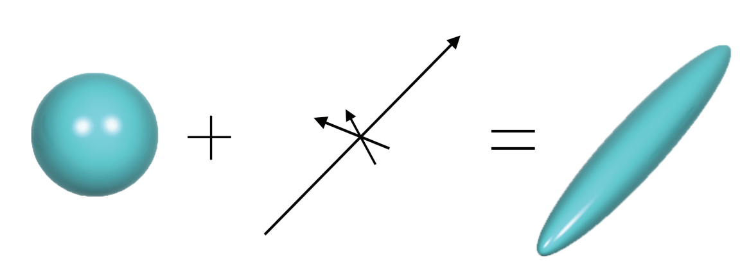
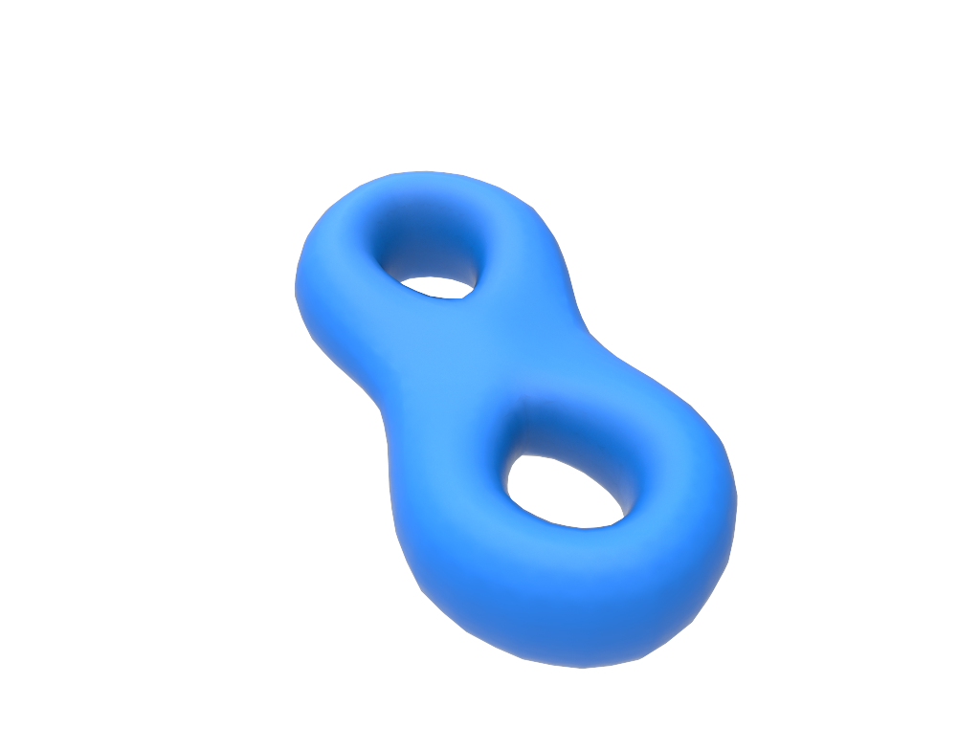
Tensor Fields
Sphere
Tensor
Ellipsoid
Porosity: 50%
Kernels: 1000
Model
Tensor Field
Parameters
Porous Model
Notes:
First of all, the tensor field.
We use tensor to represent the anisotropy in this work. Tensor has different values in three orthogonal principal directions.
In this figure, a tensor change the iso-surface from a sphere shape to an ellipsoid shape.
In our work, the tensor field is an input. The field can be designed or generated from a stress field.
In this picture, tensor field is designed.
Then the user selects the kernel number, for example one thousand, which means there are thousand pores in this model.
During our pipeline, the point distribution follows the blue-noise sampling method.

Slide 10
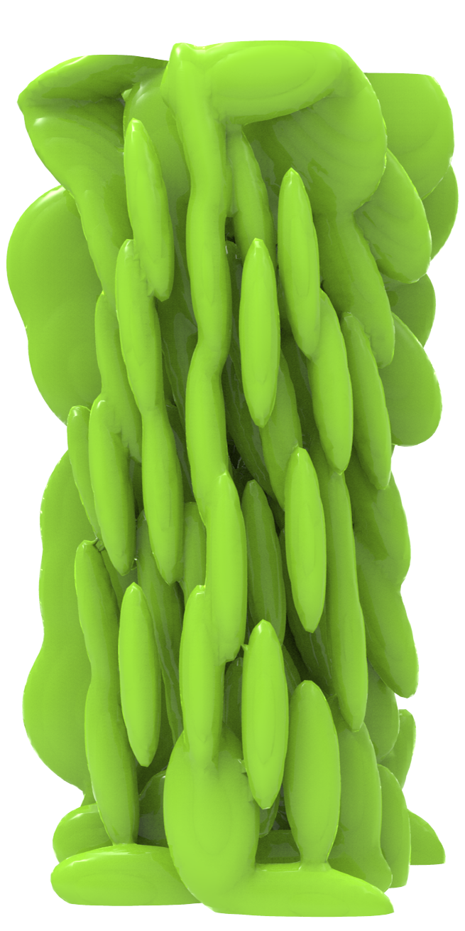
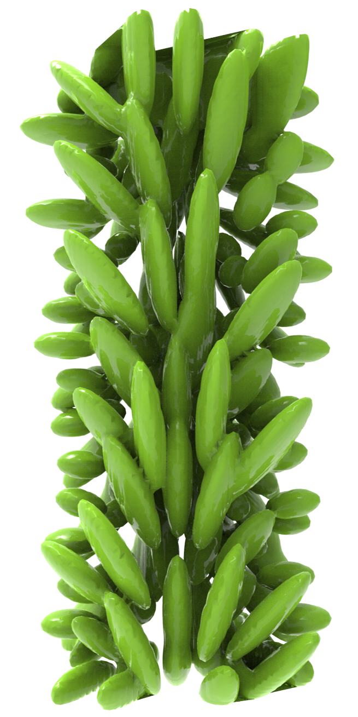
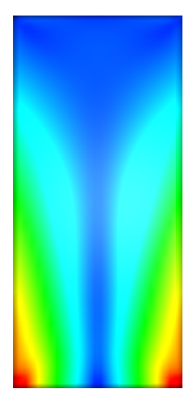
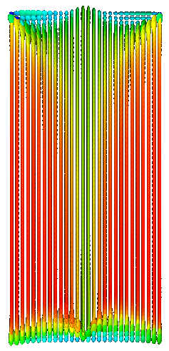
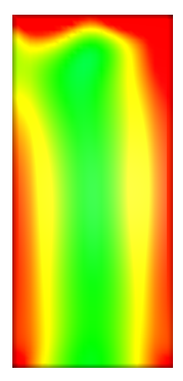
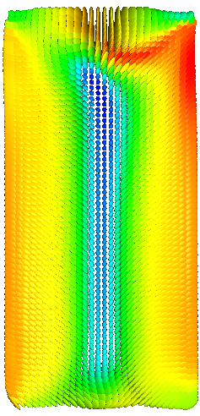
Tensor Fields
Value
Orientation
Pores distribution
Value
Orientation
Pores distribution
Notes:
In this figure, we show two different tensor fields from stress fields.
When we apply force on the boundary of the model, by the FEM method we can get the stress field of the model.

Slide 11
Pipeline
Input tensor field
Blue-noise Sampling
Transformed Gaussian Kernels
Level-surface
Notes:
Now we have the point distribution, and I will talk about the Gaussian Kernel.

Slide 12
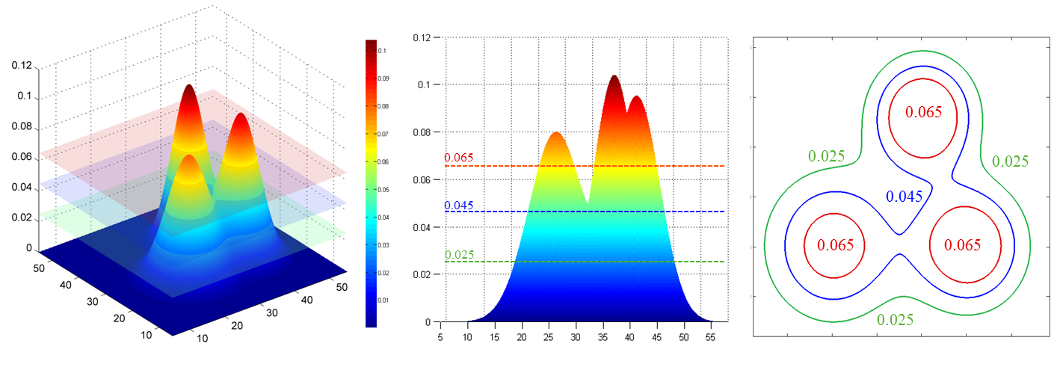
Transformed Gaussian Kernel
Implicit function, combined with the level-set
Direct control
Tensor awareness
Limited number of parameters to locally change pores
Solid
Pore
Pore
Pore
Notes:
Why do we use the Gaussian kernel?
First, it’s can be represent as a implicit function in the model, and easily combined with level-set.
We can directly control the kernel with limited parameters to locally change pores.
And we call it transformed gaussian kernel. Because we adjust the function, to make the kernel shape transformed by the tensor.
We use this function to represent a pore. I use 2D figures to express the method easily.
For example, there are three pores, which are three kernels in the space.
When we apply a level-set, it separate the space to several parts.
We define the part with lower value is the solid part of the model.

Slide 13
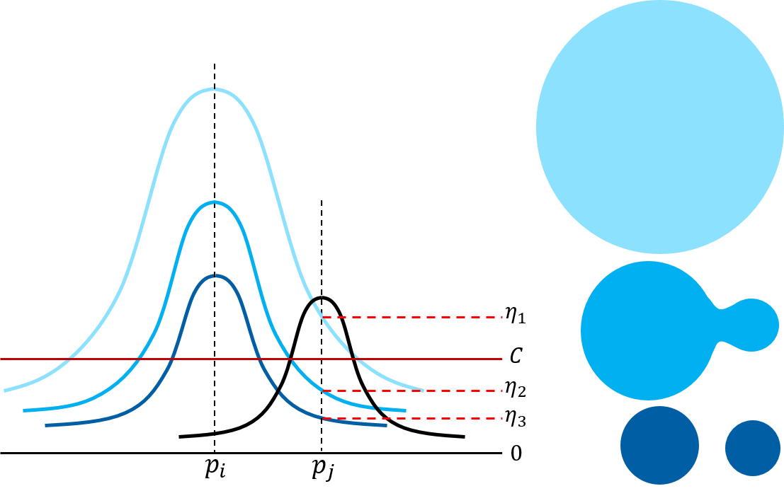
Notes:
Assume there are two neighbor kernels pi and pj, and the level-set value is C. The red line.
I am going to discuss how the Pi’s value effect the Pj location.
If the pi has large size, it means at the P_j location, pi’s Gaussian function value is eta1.
As shown in the light blue color, two pores are merged.
We allowed user to set upper bound of gaussian parameters, to make sure the kernel is connected but not merged. Like this one.
Two neighbor pores can be far and small. For example these two small circles. They should be neighbors, but due to the porosity constraint, they cannot connect to each other.

Slide 14
Pipeline
Input tensor field
Blue-noise Sampling
Transformed Gaussian Kernels
MSC Connection
Level-surface
Notes:
So we offer a method to check if all neighbor pores are connected.

Slide 15
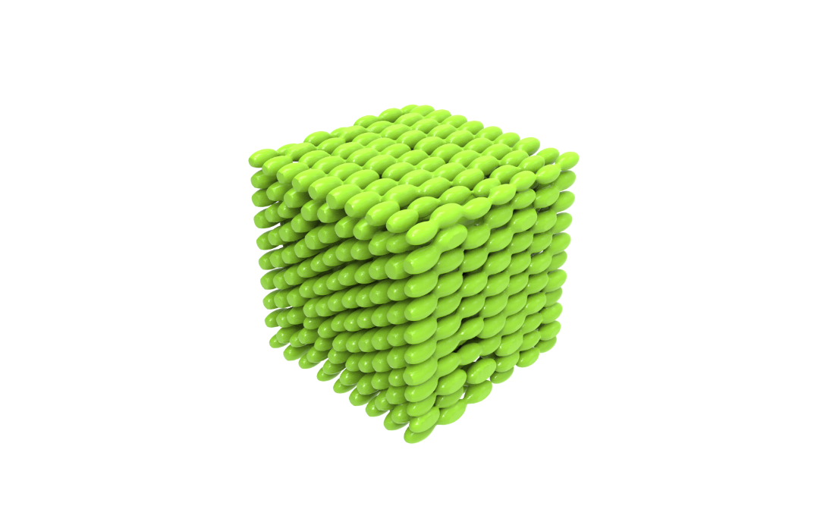
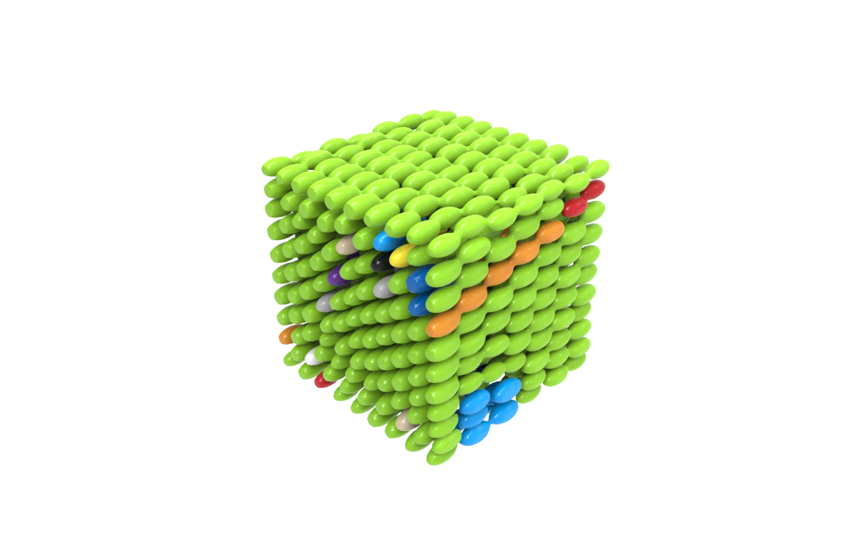
Connectivity Enforcement
Topology of connection
Different components with different colors
Connected structure
Notes:
At first, we should get the topology information of the pores.
There are plenty of connection relationship, for a set of given pores.
We want to find a measurement that can offer neighbor information, without other man-made parameters.
For example the left figure shows a topology of 4 pores connection.
And we already have the Gaussian Kernels, we should find a connection strategy, just follow the information from the scalar field.
So, we use a concept called Morse-smale complex. I will call it MSC.

Slide 16
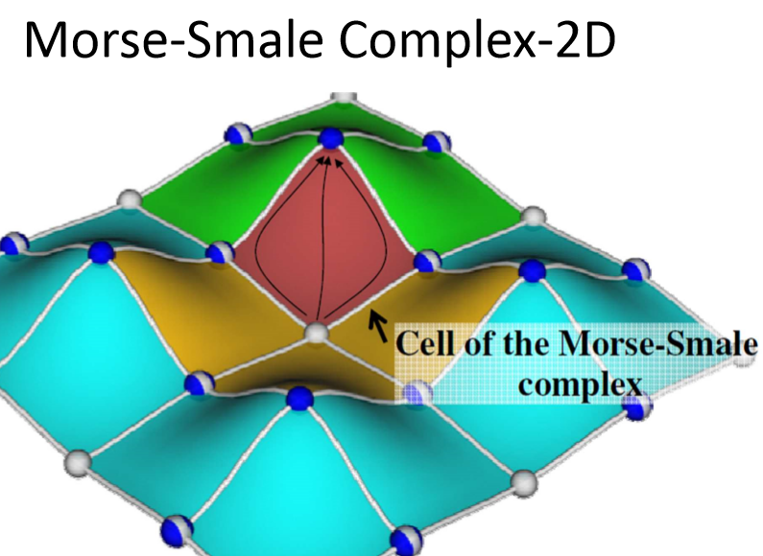
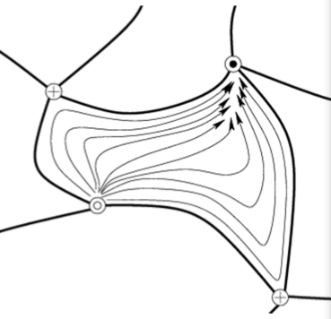
Morse-Smale Complex (MSC)
[Gyulassy et al.]
Notes:
We still use 2D case to introduce the MSC.
In a scalar field, the higher location has larger scalar value.
The whole space has three types special points.
The local minimum,
saddle points,
and the local maximum.
Along white color gradient lines, we can connect minimum, saddle, and maximum.
Then the space is divided to many cells of MSC. Like the red one.
When we focus on one cell, all the gradient lines start from the minimum will end at the maximum.
All cells have 2 saddle points, a minimum and a maximum.

Slide 17
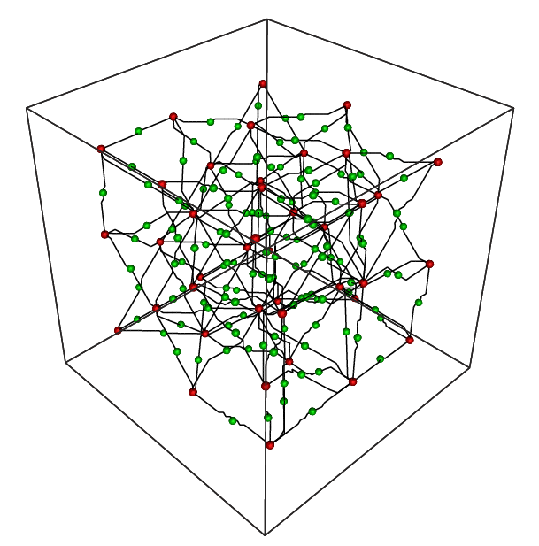


Morse-Smale Complex
3D MSC Cell
[Gyulassy et al. 2006]
Maximum and 2-saddle points
Minimum and 1-saddle points
Notes:
In 3D case, the MSC cell is a little bit complicated.
The cell has 3 kinds of special points. Minimum connects to 1-saddle points, maximum connects to 2-saddle points.
In our work, we combine the Gaussian function and MSC. The kernel is the maximum point of MSC cell.
We do not need to represent all MSC cell in 3D, because we only use MSC to control the pore connectivity and solid connectivity.

Slide 18





Morse-Smale Complex
Fat curve
[Mestetskii 2000]
Maximum
2-saddle
Pores Connection
Pores
Solid
Minimum
1-saddle
Solid Connection
Solid
Pores
Compute neighbors
  for pores and solid parts
Connect by tunnels
Corresponding structure
Notes:
In the upper figure, the red points are gaussian kernels, at the same time it’s the maximums of the MSC cell.
The green points are all 2-saddle points.
So, we get the connection of all pores.
In the lower figure, the blue points are minimum, which are inside the solid part. And yellow points are 1-saddle.
If we detect there is a isolated solid part, we connect them by the same way.
These are the corresponding structures.
To generate the connection with smooth surface, we use fat curve. It is the trace by a moving sphere of a changing radius.

Slide 19
Pipeline
Input tensor field
Blue-noise Sampling
Transformed Gaussian Kernels
Porous Structure Extraction
MSC Connection
Level-surface
Notes:
After the connectivity enforcement, we can get the porous structure.
The green models are pores, and blue models are solid.

Slide 20
Modelling Capabilities and Results
Porosity and Cell Size Control
Pore Shape Control
Medical Implants Modelling
Area Optimization
Strength Optimization
Notes:
Here are the Modelling Capabilities and Results of our modelling framework.

Slide 21


Porosity and Cell Size Control
20%
50%
Notes:
We can generate models with different porosity and cell size, in different tensor field input.
We show twenty and fifty percent volume, isotropic structures which has different pore number.

Slide 22








Porosity and Cell Size Control
20%
50%
Notes:
And these are some structures after we design a tensor field. The results are anisotropic.

Slide 23


Pore Shape Control
Notes:
User can also design porous structures of pore shapes with given tensor fields.
For the given shape, the tensor field can be predesigned by interactive tools.
And the user can adjust the density, porosity, and pore shapes, to get artistic modeling.
//
Jonathan Palacios, Lawrence Roy, Prashant Kumar, Chen-Yuan Hsu, Weikai Chen, Chongyang Ma, Li-Yi Wei, and Eugene Zhang. 2017. Tensor Field Design in Volumes. ACM Transactions on Graphics (2017).

Slide 24


Medical Implants Modelling
Constructed tensor field
Target porosity
Porosity: 60%
Pore Size: 0.5 mm
Vertebra model
Half vertebra
Notes:
One of the applications is medical implants design.
Based on the suggestions from medical doctors, for the vertebra, the porosity is around sixty percent, and the pore size around the surface is constraint.
Considering pressure direction and the boundary pore size, We design the tensor field.
It shows the anisotropy, and pore size of inside is larger than the surface.

Slide 25





Area Optimization
Initial structures
Optimized structures
Notes:
And the medical doctors also claim that,
For medical models, if the internal surface area is large, the tissue growth is better.
To this reason, we choose the surface area, as one of our optimization goal.
In this case, the tensor field is designed, too.
The left side is the initial structure. During several iterations, the result has the largest area.

Slide 26




Strength Optimization
Input force
Tensor field
MSC Connection
Initial
Optimized
Notes:
We also optimize the strength-to-weight ratio.
Our goal is to get the lightest weight model. At the same time, it must has enough strength under the external force.
In this case, the tensor field is generated by the stress field, from the origin model.
The optimization variables are pores. This figure picks out 4 structures in a optimization iteration.
The initial model is weak, so it will be crashed by the external force.
After the optimization, the structure is strong enough.

Slide 27

Comparisons
[Wu et.al. 2018]
CT-scanned Bone structure
Ours
Notes:
Here are some comparisons.
As you can see, our organic porous structure are similar to the CT-scaned bone structure.
//ours is organic!

Slide 28





Fabricated Results
Notes:
There are some 3d-printed models.
All models have appeared before.
About left side models, we print it by the FDM printer, with solvable supporting structure during the fabrication.
And the right side are models printed by the powder based 3d printing without any support.
We admit that our modeling framework does have the limitation.
That is, we don’t guarantee the self-supporting. And we are already working on this property, to make sure it can be fabricated more generally.

Slide 29
Conclusion
We present a modeling framework that automatically generates organic open-cell porous structures, conforming to given tensor fields.
Our algorithm guarantees the connectivity of both solids and pores via an MSC-based enforcement method and supports controllable porosity, density, and pore shapes.
Our optimization framework can be adapted to different objectives, like the internal surface, mechanical properties, etc.
Notes:
Let me make a brief conclusion.
We can generate organic porous structure.
And make sure the pores are connected.
We can control porosity, density and pore shapes.
After all, the framework can adapt to different optimization objectives.

Slide 30

Thank You For Listening! http://irc.cs.sdu.edu.cn/Porous/index.html
Lihao Tian, Lin Lu*, Weikai Chen, Yang Xia, Charlie C. L. Wang, Wenping Wang
Notes:
Here is our project link. You can download several porous models from this page!
Thank you very much for listening!

