Slide 1
Dapper: Decompose-and-Pack for 3D Printing
Xuelin Chen Hao (Richard) Zhang Jinjie Lin Ruizhen Hu
Lin Lu Qixing Huang Bedrich Benes Daniel Cohen-or Baoquan Chen

Slide 2
Shape “compaction”
Not compression (= compaction of shape representation)
“Compress” shape configuration to save physical space
Optimize physical composition or arrangement of shapes or parts

Slide 3
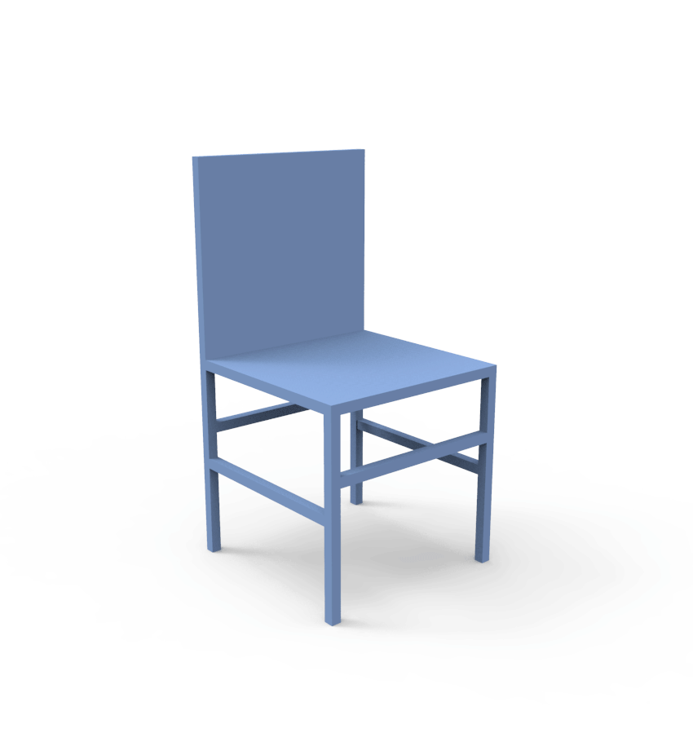
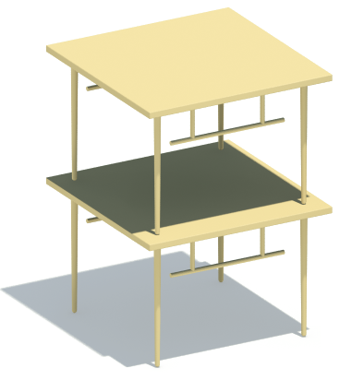
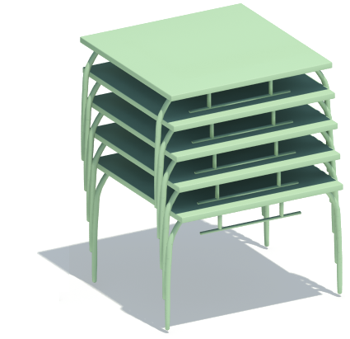
Shape “compaction”
Not compression (= compaction of shape representation)
“Compress” shape configuration to save physical space
Optimize physical composition or arrangement of shapes or parts
Examples: stacking, folding, packing, …
Stackabilization [Li et al. Siggraph Asia 2012]
Foldabilization [Li et al. Siggraph 2015]

Slide 4
From “Chopper” to “Dapper”
Stackabilization (2012): how to optimize a shape to stack better?
How about packing: more general than stacking

Slide 5
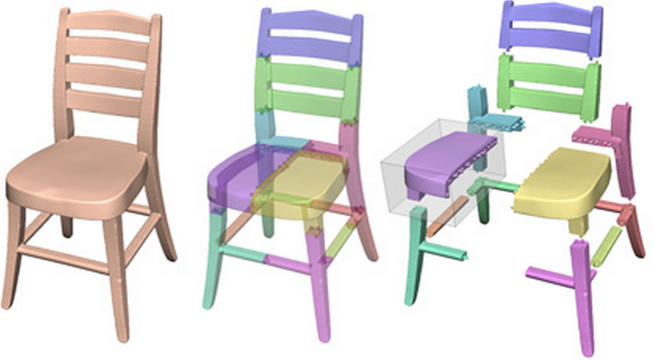
From “Chopper” to “Dapper”
Stackabilization (2012): how to optimize a shape to stack better?
How about packing: more general than stacking
“Chopper” (2012) for 3D printing
Decomposition to print large objects: cannot fit in print volume
[Luo et al. Siggraph Asia 2012]

Slide 6
From “Chopper” to “Dapper”
Stackabilization (2012): how to optimize a shape to stack better?
How about packing: more general than stacking
“Chopper” (2012) for 3D printing
Decomposition to print large objects: cannot fit in print volume
Decompose And Pack = DAP = Dapper
Maximal utilization of limited print volume
[Luo et al. Siggraph Asia 2012]

Slide 7
DAP: a pretty hard problem
Insist on not treating DAP as
D only, e.g., based on some pre-determined part property such as convexity
D and THEN P = decompose in some nice way and THEN pack
D and P must be strongly coupled
Notes:
Why is dap so hard?
Because Each of the two problems(D and P) is very difficult on its own. (CLICK) Combining the two problems is likely to increase the problem’s complexity.
And in DAP problem, (CLICK) there is no prescribed set of parts to pack, (CLICK) no pre-determined part property to drive the decomposition.

Slide 8
DAP: a pretty hard problem
Insist on not treating DAP as
D only, e.g., based on a pre-determined part property such as convexity
D and THEN P = decompose in some nice way and THEN pack
D and P must be strongly coupled
Packability: not a property possessed by a part alone
No pre-determined part property to drive the D
You can only know after you pack
Most instances of D and P are NP-hard
Notes:
Why is dap so hard?
Because Each of the two problems(D and P) is very difficult on its own. (CLICK) Combining the two problems is likely to increase the problem’s complexity.
And in DAP problem, (CLICK) there is no prescribed set of parts to pack, (CLICK) no pre-determined part property to drive the decomposition.

Slide 9
An “easier” problem?
Let us only decompose, no packing
But beyond just decompose-to-fit (into limited print volume)
Decompose so each part is best for 3D printing
So what geometric (part) property is most printing-friendly?
Notes:
Why is dap so hard?
Because Each of the two problems(D and P) is very difficult on its own. (CLICK) Combining the two problems is likely to increase the problem’s complexity.
And in DAP problem, (CLICK) there is no prescribed set of parts to pack, (CLICK) no pre-determined part property to drive the decomposition.

Slide 10
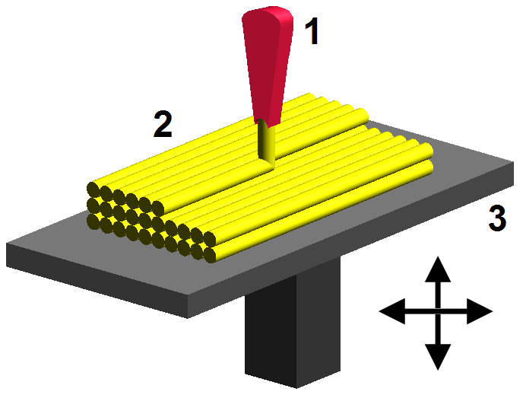
Pyramidal shapes
Vertical orientation
A pyramidal shape models a height function over a flat base
A flat base
No support (waste) material for layered (FDM) printing; also shorter print time.

Slide 11
Pyramidal decomposition
Decompose a shape into a small number of pyramidal parts
Far from an easy problem!
[Hu et al. Siggraph Asia 2014]
Notes:
Why is dap so hard?
Because Each of the two problems(D and P) is very difficult on its own. (CLICK) Combining the two problems is likely to increase the problem’s complexity.
And in DAP problem, (CLICK) there is no prescribed set of parts to pack, (CLICK) no pre-determined part property to drive the decomposition.

Slide 12
Between 2012 and 2015
Discrete scissors congruence [Zhou & Wang 2012]
DAP into shape with exactly same volume and no overlap
Impractical for 3D printing: too many parts; very slow algorithm
PackMerger [Vanek et al. 2014]: decouples D and P
Next paper in this session
Volume = 16

Slide 13
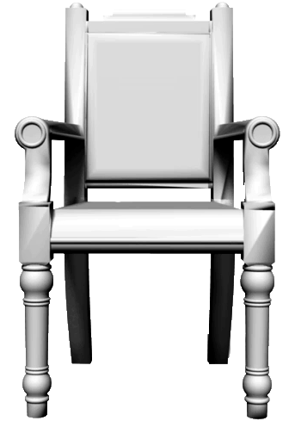
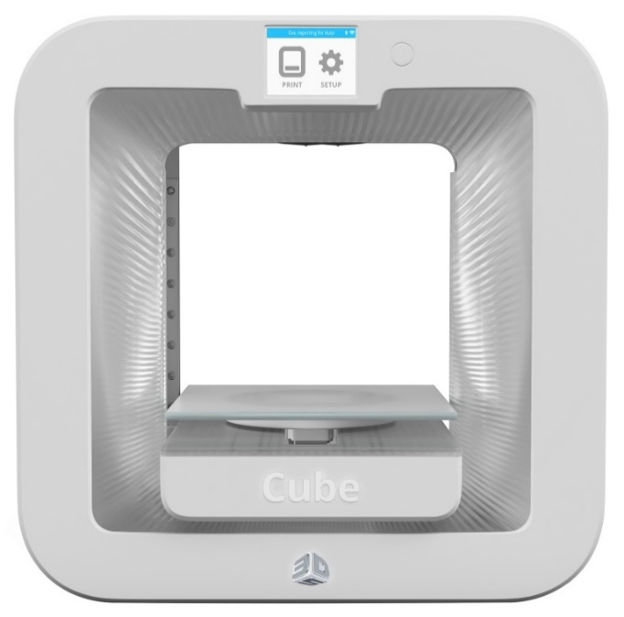
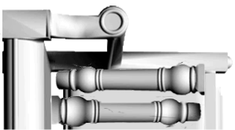
Back to DAP in 2015
Given a 3D shape S and a print volume V, decompose S into a small number of parts to be packed compactly into V
S
V
Notes:
Therefore, We pose DAP problem.
To decompose and pack an object into a container under some certain constraints, this is extremely hard.
//
In the classical setting,
decomposition seeks to partition a given object into a small number
of parts with each satisfying a desirable geometric property, and
packing involves placing a set of given objects into a given container.

Slide 14
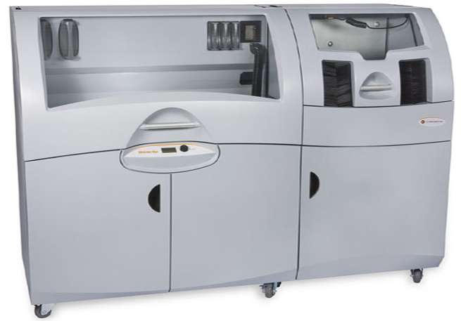
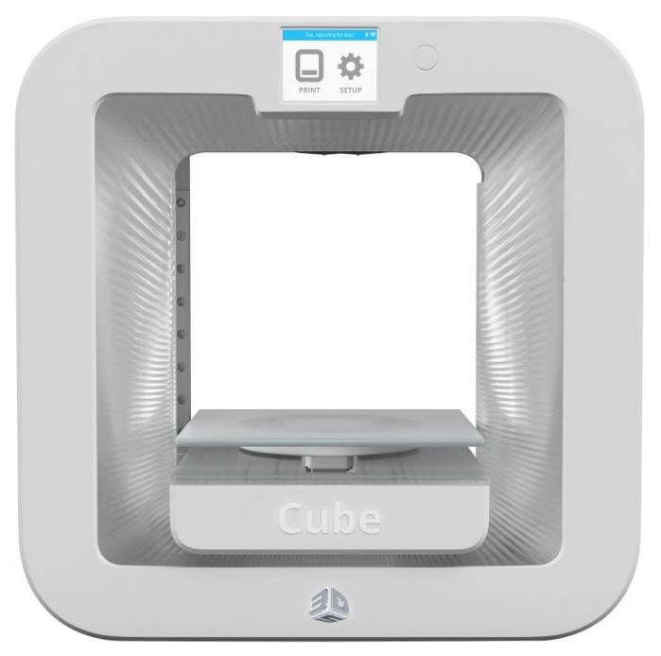
Back to DAP in 2015
Geared towards 3D printing to reduce
support material, build time, and assembly cost (low part counts)
Powder- and FDM-based 3D printers
Notes:
((CLICK) )It is geared towards 3D printing, minimizes support material, build time and assembly cost when decompose and pack an object.
And(CLICK)it can be applied to both powder and FDM-based 3D printers

Slide 15
Challenges remain
Still insist on strong coupling of D and P
Too expensive if allow arbitrary decomposition and packing
Keys to make the problem tractable:
Restrict the set of primitives to consider
Restrict cuts and packing transformations
Settling for heuristics (perhaps less elegant)
Notes:
Pyramidal primitives have many advantages.
The pyramidal primitives gain their(CLICK) efficiency from their representational simplicity: they are 2.5D with a flat base, only the top side need to be processed.
The pyramidal primitives are(CLICK) packing- and printing-friendly and closed(CLICK) under vertical and horizontal cuts.

Slide 16
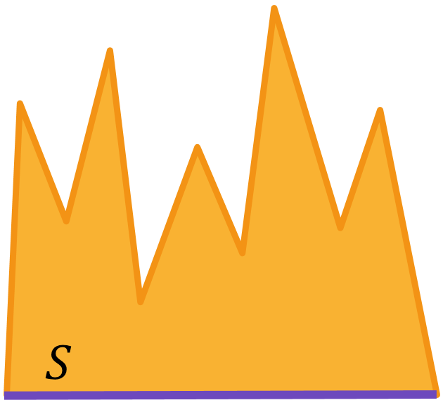
Pyramidal primitives for DAP?
Not only printing-friendly, but also packing-friendly
No inner pockets to fill
Packing = matching of “teeth”, i.e., only one side, the (height) function side
Notes:
Pyramidal primitives have many advantages.
The pyramidal primitives gain their(CLICK) efficiency from their representational simplicity: they are 2.5D with a flat base, only the top side need to be processed.
The pyramidal primitives are(CLICK) packing- and printing-friendly and closed(CLICK) under vertical and horizontal cuts.

Slide 17
Pyramidal primitives for DAP?
Not only printing-friendly, but also packing-friendly
No inner pockets to fill
Packing = matching of “teeth”, i.e., only one side, the (height) function side
Closure under axial cuts (decompositions)
Notes:
Pyramidal primitives have many advantages.
The pyramidal primitives gain their(CLICK) efficiency from their representational simplicity: they are 2.5D with a flat base, only the top side need to be processed.
The pyramidal primitives are(CLICK) packing- and printing-friendly and closed(CLICK) under vertical and horizontal cuts.

Slide 18
Pyramidal primitives for DAP?
More general than (packing + printing-friendly) boxes
Expect less number of parts: lower assembly cost, etc.
Perfect DAP with 4 pyramidal parts
Perfect DAP with 7 box parts
Notes:
Pyramidal primitives have many advantages.
The pyramidal primitives gain their(CLICK) efficiency from their representational simplicity: they are 2.5D with a flat base, only the top side need to be processed.
The pyramidal primitives are(CLICK) packing- and printing-friendly and closed(CLICK) under vertical and horizontal cuts.

Slide 19
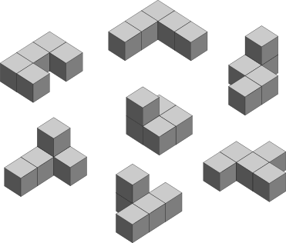
Reduce space for global search
Decompose into and pack only pyramidal polycubes
Voxelize shape and only allow axial cuts
Closure property with pyramidal primitives
Discretizing rotations to 90 degrees
Just like Tetris!
Arbitrary rotations allowed in local refinement
Notes:
Pyramidal primitives have many advantages.
The pyramidal primitives gain their(CLICK) efficiency from their representational simplicity: they are 2.5D with a flat base, only the top side need to be processed.
The pyramidal primitives are(CLICK) packing- and printing-friendly and closed(CLICK) under vertical and horizontal cuts.

Slide 20
Algorithm Overview
Initial decomposition
Global DAP optimization
Local refinement
Pyramidal polycubes
Optimal pile
Lower and tighter pile
Notes:
Now, let us see the system pipeline.
Given an input shape, Our algorithm starts with(CLICK) an initial pyramidal decomposition, then voxelize the pyramidal parts to generate polycubes.
The second step(CLICK) is an Global DAP optimization, during this step, the algorithm aims to find an optimal pile during the search;
After global DAP optimization step(CLICK), we extract the mesh inside each polycube, then apply local refinement process to obtain a lower and tighter pile.

Slide 21
Algorithm Overview
Initial decomposition
Global DAP optimization
Local refinement
Pyramidal polycubes
Optimal pile
Lower and tighter pile
Notes:
Now let us start with the initial decomposition step

Slide 22
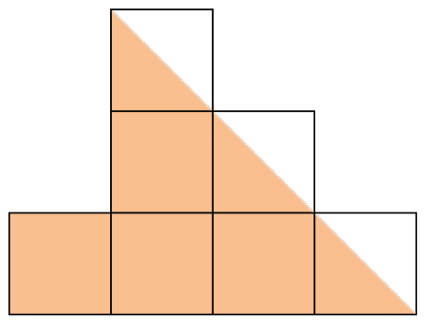
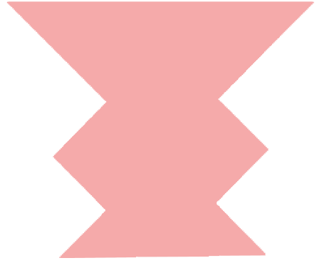
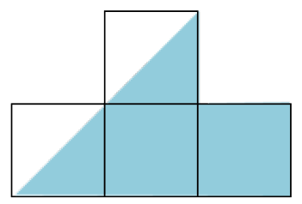
Pyramidal Polycubes Generation
Pyramidal Decomposition
[Hu et al. 2014]
Pyramidal polycubes
Notes:
Given an input shape, we use(CLICK) pyramidal decomposition to obtain a small number of(CLICK) pyramidal parts, Then we upright-orient each initial pyramidal part along its up direction and voxelize(CLICK) the part to generate((CLICK)) the pyramidal polycubes.

Slide 23
Algorithm Overview
Initial decomposition
Global DAP optimization
Local refinement
Pyramidal polycubes
Optimal pile
Lower and tighter pile
Notes:
Then the algorithm goes to a global search for the optimal pile. The primitive we manipulate at this step is the pyramidal polycube.

Slide 24
Powder-based Printers
Height of the pile
Powder-based Printers(sensitive to height)
Pile in the container,
The lower, the better.
Notes:
When we detail our global DAP optimization, our coverage is focused on powder-based 3D printers(CLICK).
Later, we will explain how to adjust our method for FDM-based printers.
As we know, the powder-based printer is sensitive to the height(CLICK) of the pile in the container. So we aim to minimize the height of the pile while using a small number of parts.

Slide 25
Global DAP Optimization
We formulate DAP for powder-based fabrication as:
Height of the pile
Height of container
$$P^{∗}= \underset{full pile P}{argmax}{O_{PWD}\left(P\right)= \underset{full pile P}{argmax}{\frac{H\left(C\right) −H(P)}{N^{α}}}}$$
Tunable parameter
Number of parts
Low piles with few parts
Notes:
So we formulate dap for powder-based fabrication as follows,
This formulation takes(CLICK) the height of the pile and the(CLICK) number of parts into account.
Our goal is to maximize the objective function to obtain(CLICK) a low pile solution while using a small number of parts.
The optimal solution for dap is attained by a full pile, a pile consisting of all parts.
Then, let us see how we use beam search to search for an optimal solution.

Slide 26
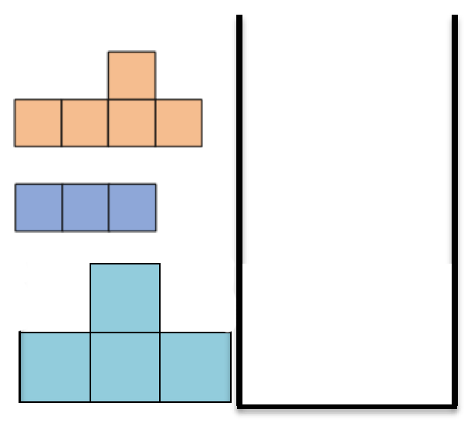
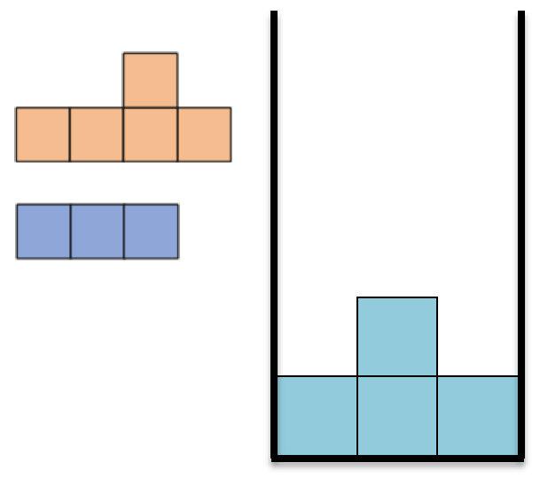
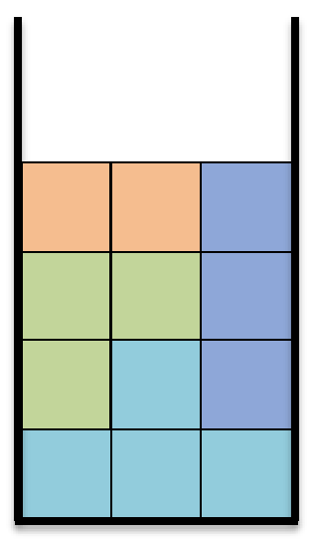
Global DAP Optimization – Solution
…
…
Initial partial solution
Partial solution
Full solution
Notes:
First(CLICK), our global DAP optimization starts with an initial empty partial solution, then search for a full optimal solution move by move(CLICK)(CLICK).
So as shown here, the search space consists of sequences of moves supported by Dapper
//Each partial solution to DAP consists of a set of unpacked polycubes and a packed pile in the container consisting of a set of packed polycubes.

Slide 27
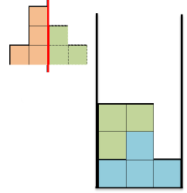
Global DAP Optimization – Move
PAK: This move packs a part onto the pile.
CAP: This move cuts a part and packs one of the resulting pieces onto the pile.
Notes:
One of the two moves supported by our dapper is PAK(CLICK) move, this move packs a part onto the pile without any cuts.
Another move is CAP(CLICK) move, this move cuts a part and packs one of the resulting pieces onto the pile(CLICK)
All cuts are axis-aligned, straight, and
result in one and only one additional part. It is easy to see that the
set of pyramidal polycubes is closed under such cuts.

Slide 28
Global DAP Optimization – Priority Score
How to choose the next move?
We define a priority score to select the candidate next moves.
$H_{GAIN}\left(v,P\right)=H\left(C\right)−H(v)$
$$M_{PWD}\left(q,P\right)= \frac{\sum_{v∈P⨁q}{H_{GAIN}(v,P)}}{N^{α}} − η⋅ G_{PWD}(P⨁q)$$
Tradeoff between height gain and part count
Penalty for vertical gap
Compact piles
Notes:
Then, as we build up a sequence of moves, we need to know how to choose the next move. The next move chosen should lead us towards a globally best final solution.
So, here we define (CLICK)(CLICK)a priority score to select the candidate next moves when a part q is packed onto the pile P;
The first term(CLICK) is a tradeoff between the height gain and the part count after the pack;(CLICK) and for a voxel v in the pile, the height gain
at v is the difference between the container height H(C) and the actual height of v in the pile.
The second term(CLICK) is a weighted penalty for vertical gap in the pile.
with this priority score definition, (CLICK)the search will prefer more compact packings.

Slide 29
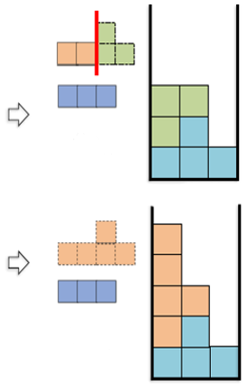
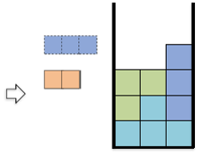
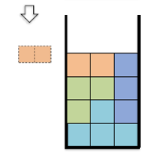
Global DAP Optimization – Search Tree
CAP
PAK
…
$$β$$
…
PAK
TreeNode
PAK
PAK
If $O_{PWD}\left(P\right)< O_{PWD}\left(P^{∗}\right)$
Then prune;
Complete solution
Notes:
Generally, we explore the search space for dap using a search tree, through a bounded beam search.
in each node(CLICK) , The tree stores a partial solution resulted by a cap move or a pak move. Here, this node is resulted by a pak move.
Then at each node, we generate beta(here, just two) children(CLCK) corresponding to the top beta moves according to their priority scores.
Then via a depth pruning process, we cut off(CLICK) entire subtrees of the search tree by comparing the partial solution with the current best full solution P asterisk, because no further search expansion is necessary beyond this node.
The search terminates when a prescribed maximum number of attempted moves is reached(CLICK) or when all solutions have been exhausted(CLICK). Then return the current best solution P asterisk.

Slide 30
Demonstration of the Search
Notes:
To better understand the process of the beam search, we show an animation of the search process. The input shape is decomposed and voxelized to generate polycubes, and then packed to the container on the right. We show here the winner sequence that leads to the best solution. It is one brunch of the beam search. Note that the polycubes are cut on-the-fly, there is no prescribed set of parts to pack.

Slide 31
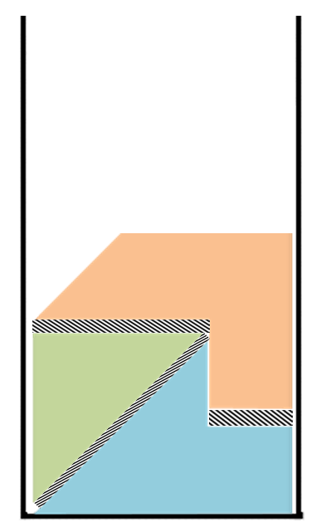
Changes for FDM-based Printers
The global objective for FDM
FDM-based Printers(sensitive to gap)
Gap in pile(shown in slash),
The fewer, the better.
Notes:
Our framework can be easily adjusted for FDM-based printers
Unlike the powder-based printers, FDM printer is sensitive to the gap in the pile. The fewer gap there exist, the better. Because the gap will cost extra support material and build time.

Slide 32
Adjustment for FDM-based Printers
We formulate DAP for FDM-based fabrication as:
Total input voxels
Gap amount
$$P^{∗}= \underset{full pile P}{argmax}{O_{FDM}\left(P\right) = \underset{full pile P}{argmax}{\frac{V\left(S\right) −G_{FDM}(P)}{N^{α}}}}$$
Tunable parameter
Number of parts
Piles with few gap
Notes:
So when we formulate the dap for FDM, we should mainly take(CLICK) the gap amount in the pile into account.
By maximizing the objective function Ofdm(P) as described here, we aim to find(CLICK) piles with few gap while using a small number of parts

Slide 33
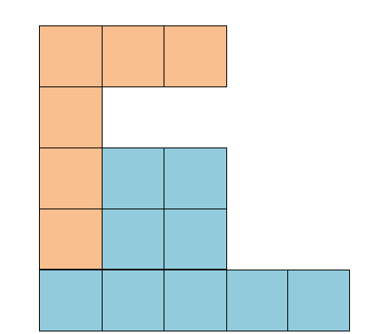
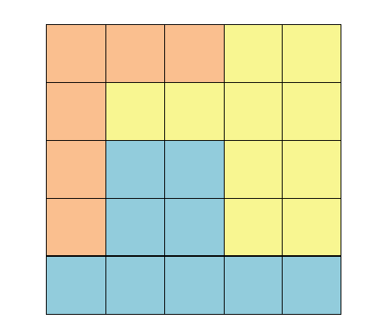
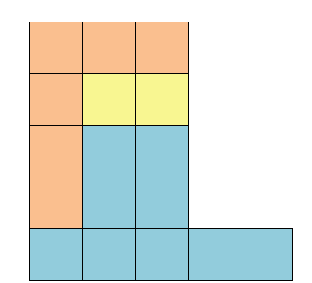
Adjustment for FDM-based Printers
Priority score: $M_{FDM}\left(q,P\right)= \frac{\sum_{v∈P⨁q}{H_{GAIN}(v,P)}}{N^{α}} − η⋅ G_{FDM}(P⨁q)$
Vertical gap
(a) Current pile
(b) Gap for powder
(->low pile)
(c) Gap for FDM
(->reduce gap)
Notes:
The priority score(CLICK) for global dap of fdm is the same as powder-based printers.
But we only need to change the way we count the vertical gap(CLICK).
Given a current pile(CLICK),
As the gap voxels shows in slash, the way we count the vertical gap for powder-based(CLICK) printer is illustrated in figure(b), which will make dapper prefer lower piles;
The way we count the vertical gap for FDM-based(CLICK) printer is illustrated in figure(c), which will make dapper prefer piles with fewer overhang.

Slide 34
Fabrication Criteria
Easily incorporate some fabrication constraints
Cut area
Part volume
Part thickness
Threshold when selecting candidate CAP moves during the solution search.
Small cut area.
Good.
Notes:
Our dap framework can also easily incorporate some fabrication constraints. Such as, (CLICK)cut area, (CLICK)part volume and (CLICK)part thickness.
Simply, by thresholding(CLICK)(CLICK) when selecting candidate cap moves during the solution search, we can add these constraints into our framework.

Slide 35
Algorithm Overview
Initial decomposition
Global DAP optimization
Local refinement
Pyramidal polycubes
Optimal pile
Lower and tighter pile
Notes:
At last, we have a local refinement process to make the pile obtained in the global DAP lower and tighter.

Slide 36
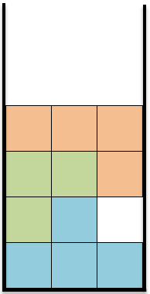
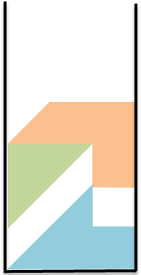
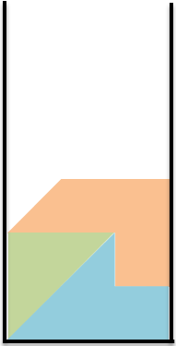
Local Refinement
Obtain N pieces
Improve the assembly
Notes:
At this step, Now we have N pieces(CLICK) obtained
from global DAP.
Then we seek to optimize for a rigid transformation for each piece to further improve the pile(CLick), to make the pile lower and more compact.

Slide 37
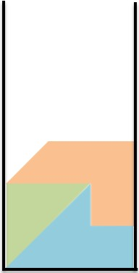
Local Refinement
We formulate it as a constrained optimization
Constraints:
bounding constraint
non-penetration constraint
Objective function:
$$f= f_{height}+ λ ∙ f_{gap}$$
Optimization via iterative linear programming
Notes:
We formulate this local refinement as a optimization problem under bounding constraint and non-penetration constraint.
We aim to minimize the objective function as follows(CLICK).
It has two terms, one for the height of the pile, one for the gap in the pile.
This optimization problem is hard to solve due to the nonlinearity of the rigid transformations
We propose to optimize sequentially, then by(CLICK) optimization via iterative linear programming, (CLICK)we can obtain a lower and tighter pile after local refinement

Slide 38
Results
Print volume setting
Rectangular cuboid with a square base
$L_{max}=1.618 ∙ A_{input}^{1/2}$ -- 2D
$A_{input}$: total area of the 2D input shape
$L_{max}=1.618 ∙ V_{input}^{1/3}$ -- 3D
$V_{input}$: total volume of the 3D input shape
Notes:
Now let’s see some results.
The print volume setting for our results is A rectangular cuboid with a square base
In 2D and 3D, The length Lmax of the base side is calculated as follows ,

Slide 39
Results for Powder-based Fabrication
2D
Notes:
This is 2D gallery of our results.
All results are obtained with the same parameter setting

Slide 40
Results for Powder-based Fabrication
3D
Notes:
Here is the 3D gallery , All results are obtained with the same parameter setting
we show the input shape, the final decomposition and packing, and a photograph of the fabricated pieces

Slide 41
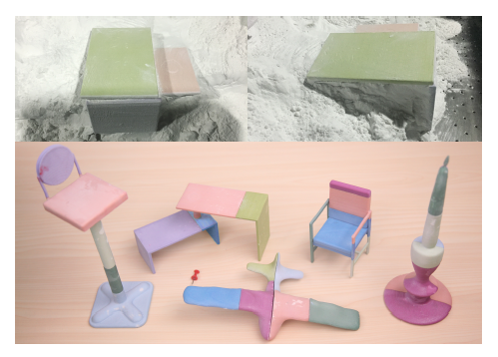
Results for Powder-based Fabrication
最后的视频拿到这里
Notes:
Here we show assembled 3D objects from the 3D gallery after gluing the pieces

Slide 42
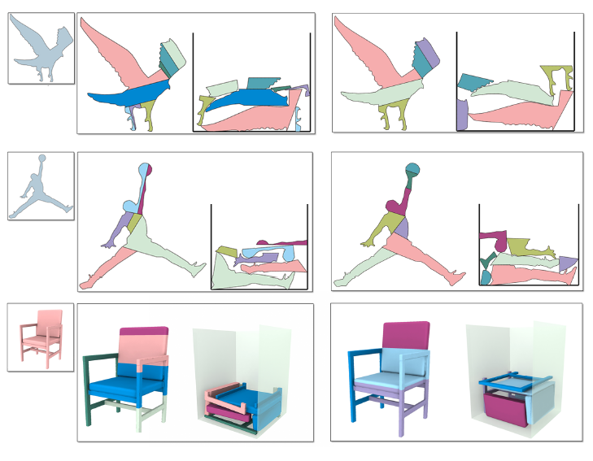
Results for Powder-based Fabrication
Fabrication constraints added
Notes:
Here we show contrasting DAP results without and with fabrication constraints
As shown in the right column(CLICK), the small cuts, small parts and thin structures are eliminated after we add the constraints.

Slide 43
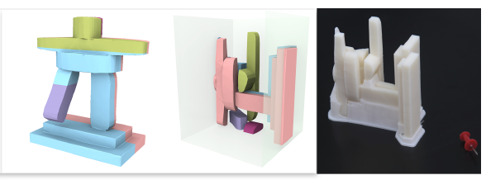
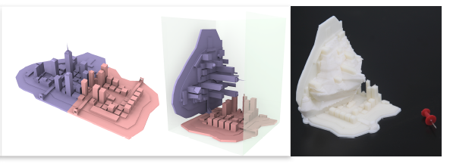
FDM Printing
Notes:
Here we also show some FDM printings after we adjust our dapper for FDM-based printers.

Slide 44
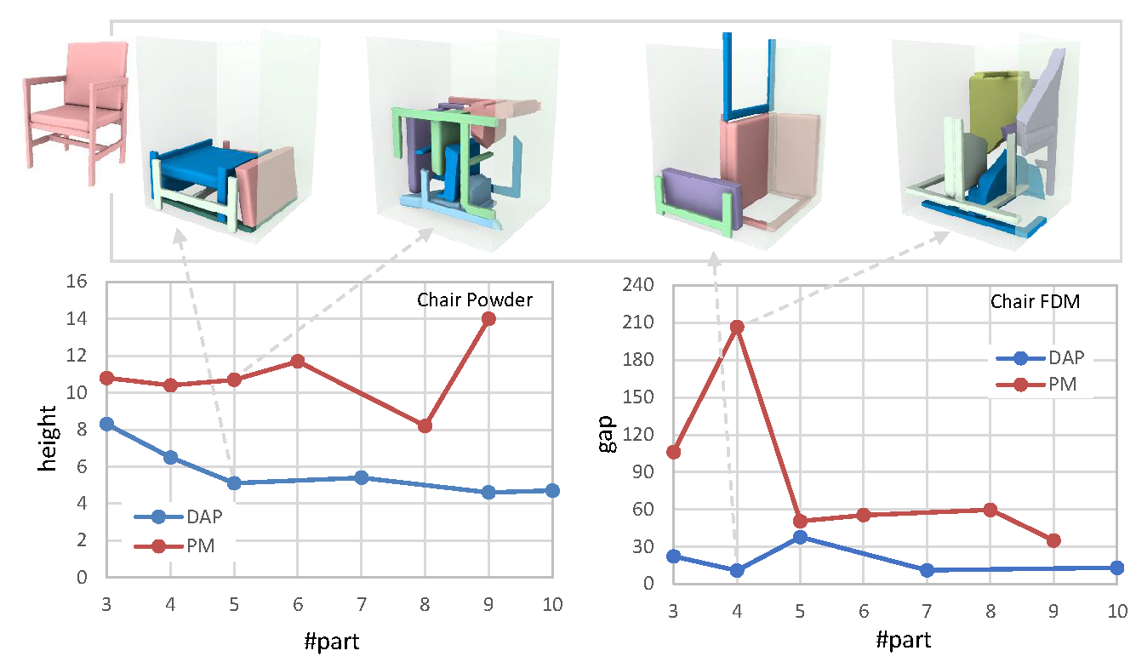
Comparison
PackMerger -- Vanek et al. [2014]
Notes:
We also compare our dapper with previous work -- packmerger.
We can see that Dapper generally outperforms PackMerger on height and gap reduction when the part number varies.

Slide 45
Conclusions
Decompose-and-pack(DAP) problem for 3D printing
Decompose and pack simultaneously is a much harder problem than each one alone
DAP represents not one, but a new class of optimization problems
Offer a preliminary solution
Notes:
To conclude,
We pose the dap problem for 3D printing, (CLICK)decompose and pack simultaneously is a much harder problem than each one alone,
(CLICK)DAP represents not one but a new class of optimization problems,
(CLICK)And We offer a preliminary solution to solve this extremely hard problem.

Slide 46
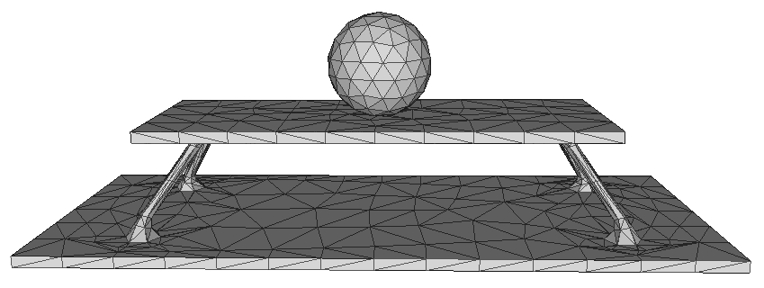
Limitations
Limited by the voxelization
rough bounds for sharp parts
disallow certain compact packing solutions
Pyramidal primitives
are not always suitable for all types of input geometry
Notes:
For the limitations,
1. (CLICK)Our dapper is limited by the voxelization, which may lead to rough bounds for sharp parts and disallow certain compact packing solutions
And(CLICK) our dapper use the pyramidal primitives, in some cases, pyramidal primitives are not always suitable for all types of input geometry. (CLICK)Objects with thin structures do not induce small pyramidal decomposition to initialize dapper.

Slide 47
Thank you!

Slide 48
Results
Parameters:
$α$ – exponent on part count in the global objective function
$β$ – beam search width
$ω$ – strip width to bound exploration of cuts at each iteration
$η$ – penalty weight on vertical gap in the priority score
$λ$ – weight placed on height minimization during local refinement
Users can tune these parameters to get different results
Notes:
There are 5 parameters in our dap core algorithm,
Users can tune these parameters to get different results.

